Slide 1

Cloud Understanding
Dr. A. Suresh, INSOFE

Slide 2
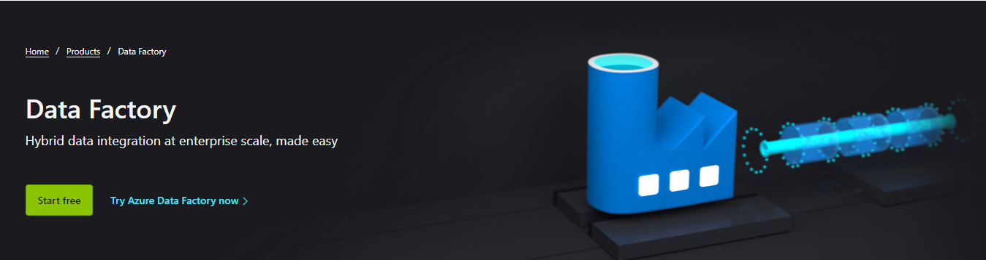
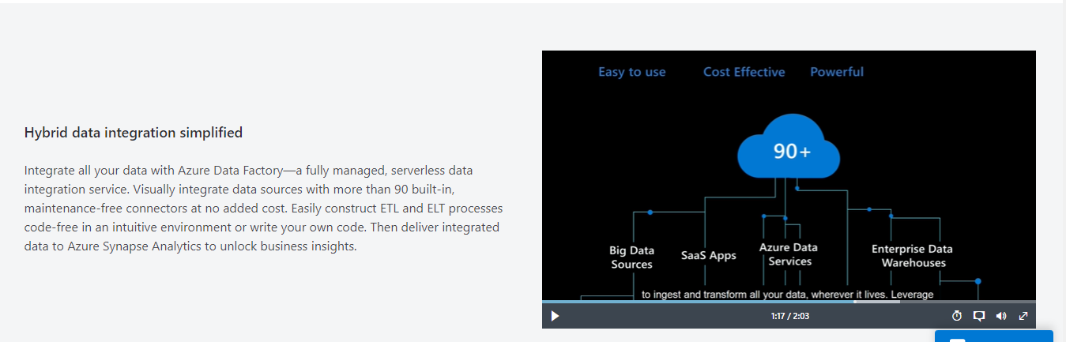

Slide 3
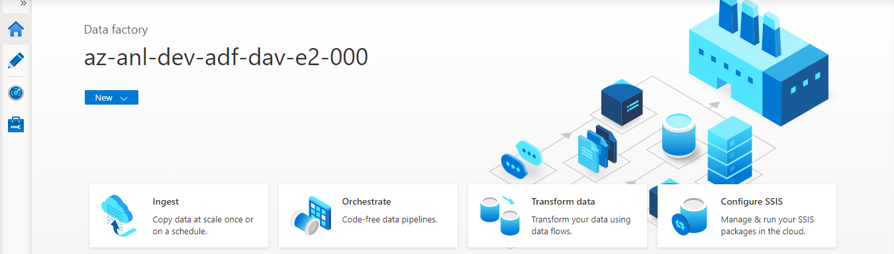
Azure Data Factory
A managed cloud service for building & operating data pipelines

Slide 4
Azure Data Factory – What Can it do?
Easily work with diverse data storage and processing systems
Transform data into trusted information
Monitor data pipelines in one place
Get rich insights from transformed data

Slide 5
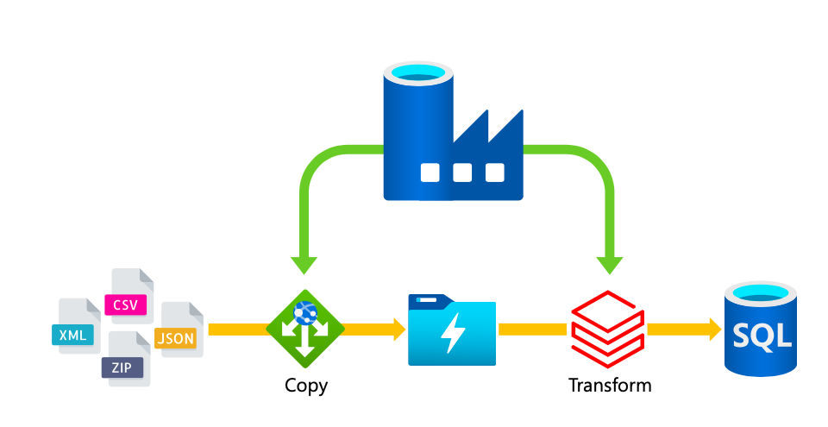
ADF - Example

Slide 6
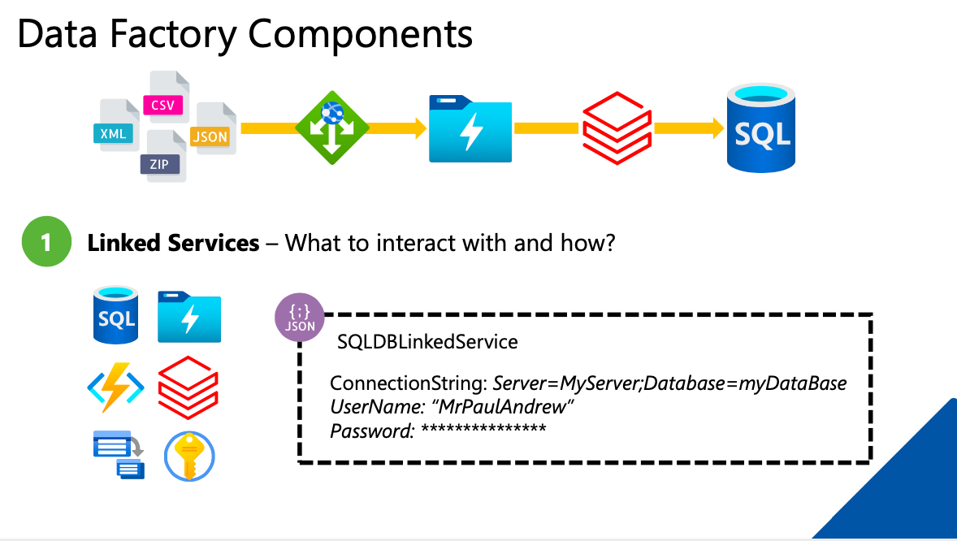

Slide 7
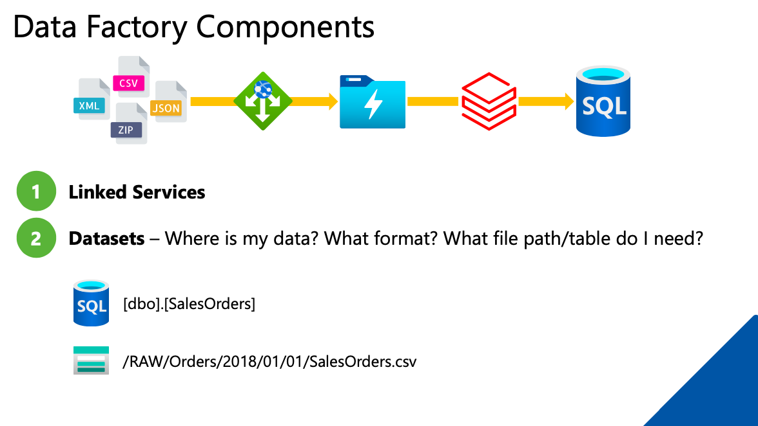

Slide 8
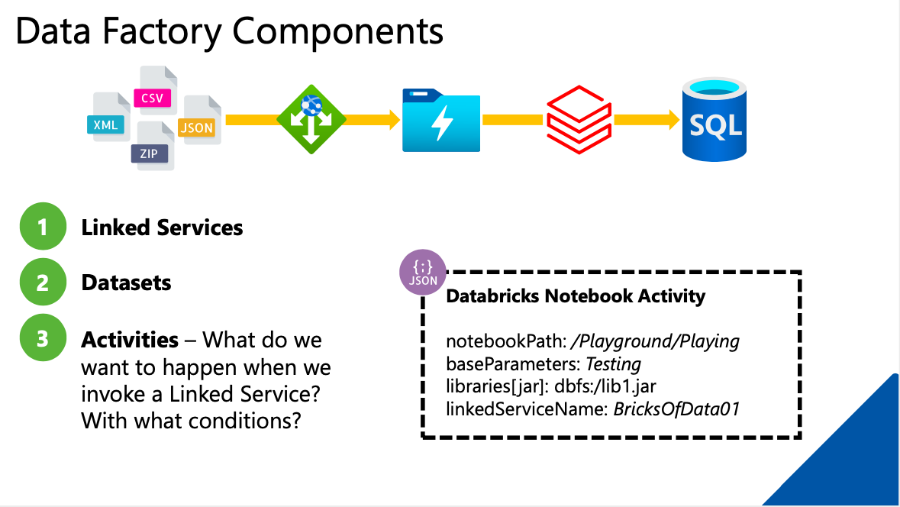

Slide 9
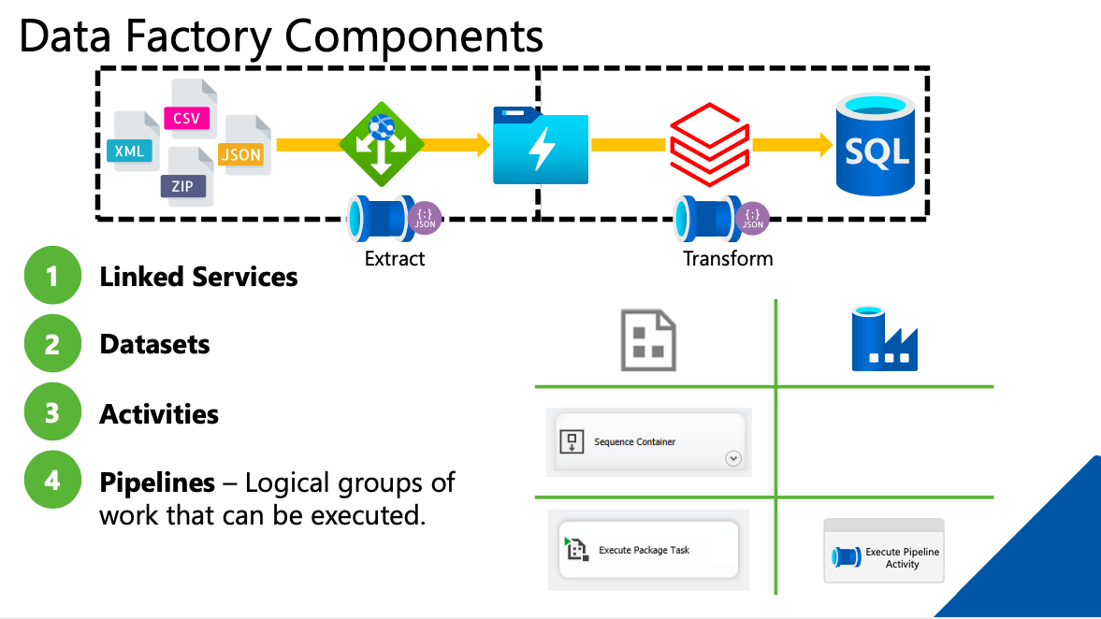

Slide 10
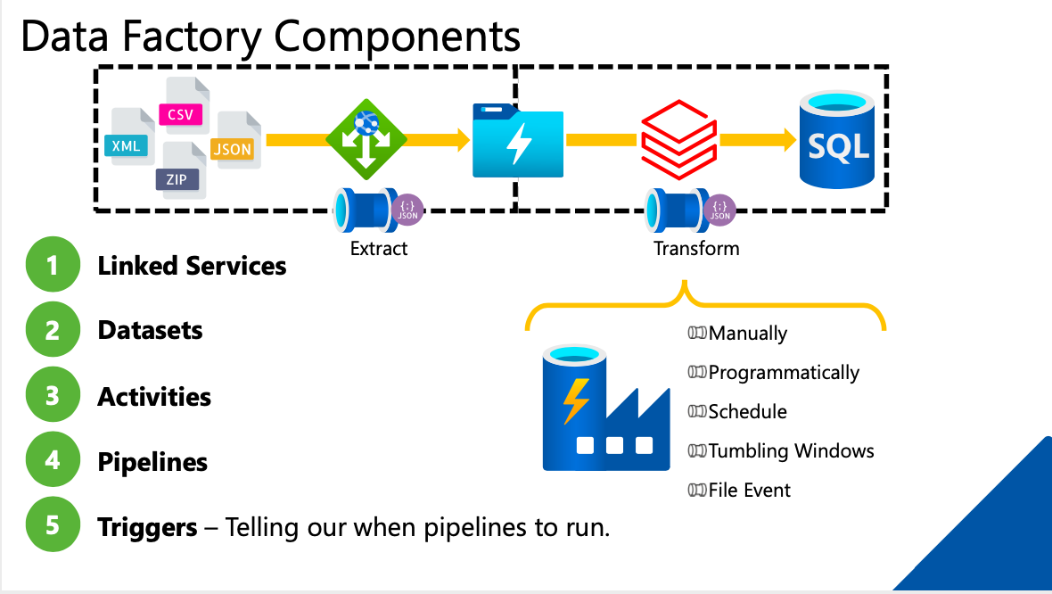

Slide 11
Summary of Components
Data Factory – Fully Managed Service
Linked Service – Link data stores & Compute Services
Data Set – Named view of data
Pipeline – Processes Data
Activity – Data Processing Step in a Pipeline

Slide 12






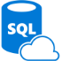
Azure Data Factory Service Data Flow Concepts
Datasets
(Collection of files, database table, etc)
Activity: a processing step
(Hadoop job, custom code, ML model, etc)
Pipeline: a sequence of
activities (logical group)
Data Sources
Ingest
Transform & Analyze
Publish
Call Log Files
Call Log Files
Transform, Combine, etc
Analyze
Move
Visualize
Customer Table
Customer Table
On Premises
Data Mart
Customer Call Details
Customers Likely to Churn
Customer Churn Table
Azure Data Lake
Azure DW

Slide 13
Demo
Create Data Factory
https://docs.microsoft.com/en-gb/azure/data-factory/quickstart-create-data-factory-portal
Copy data from Azure Blob storage to a SQL Database by using the Copy Data tool
https://docs.microsoft.com/en-gb/azure/data-factory/tutorial-copy-data-tool
Transform data using mapping data flows
https://docs.microsoft.com/en-us/azure/data-factory/tutorial-data-flow
Types of pipeline activities
https://docs.microsoft.com/en-us/azure/data-factory/v1/data-factory-create-pipelines

Slide 14
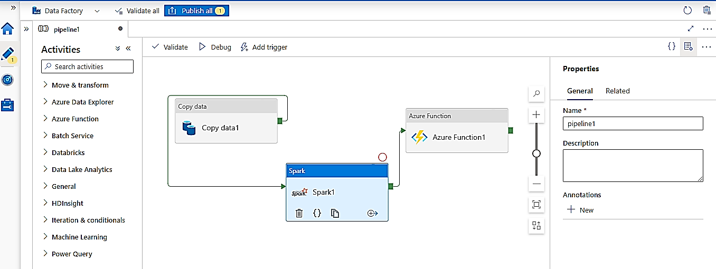
Activities & Pipeline

Slide 15
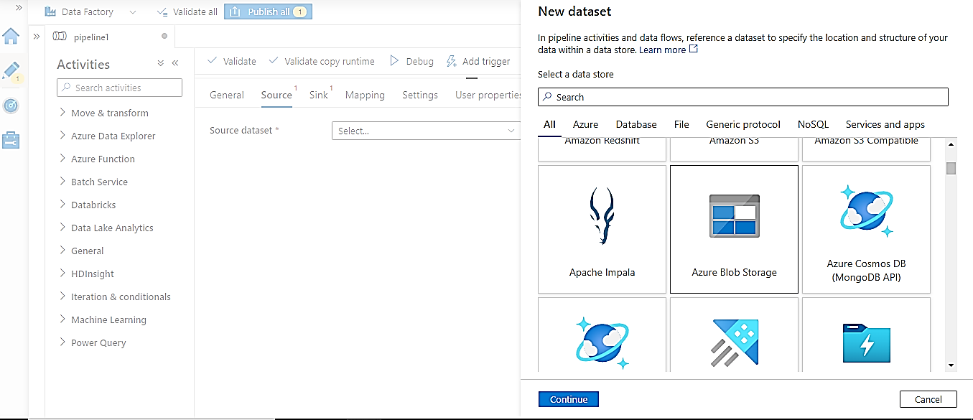
Linked Service

Slide 16
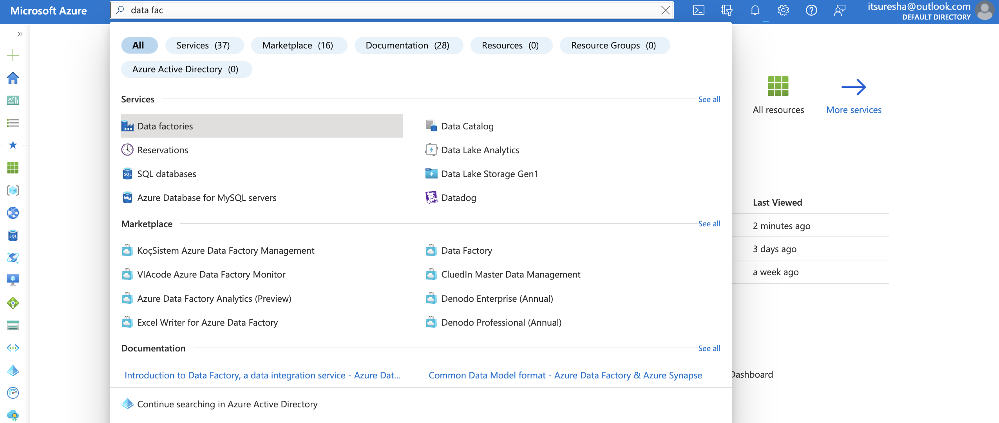
Copy Activity

Slide 17
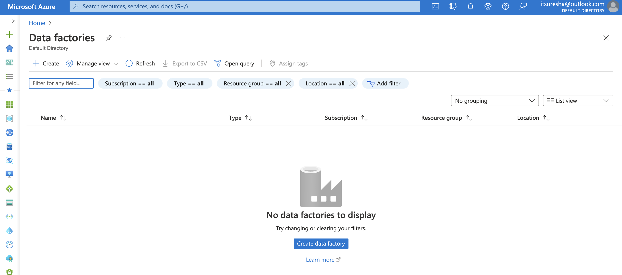
Copy Activity

Slide 18
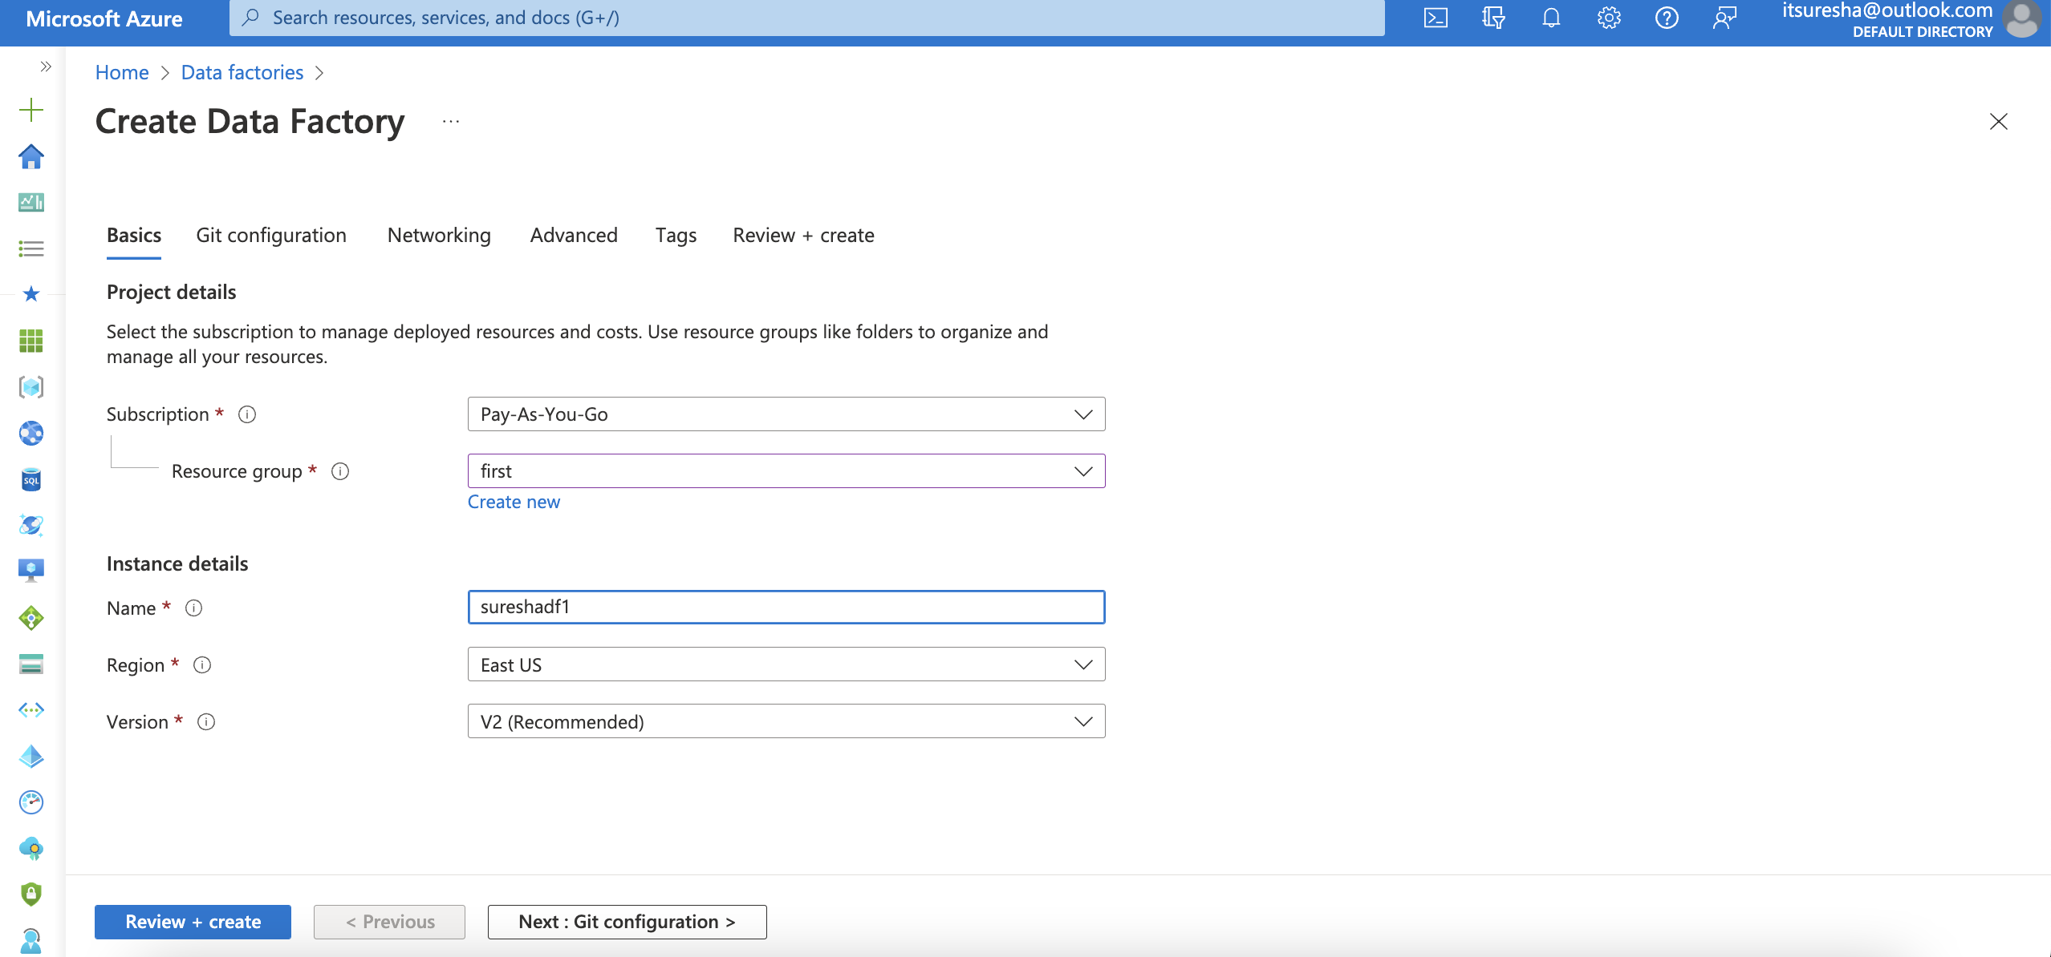
Copy Activity

Slide 19
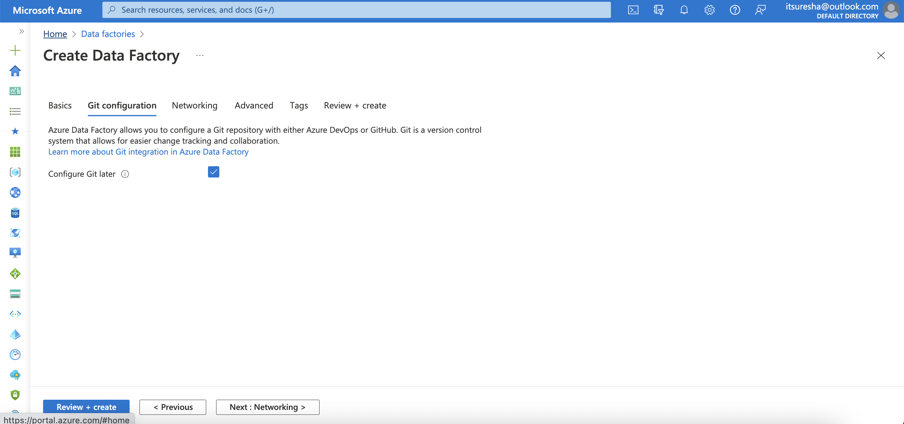
Copy Activity

Slide 20
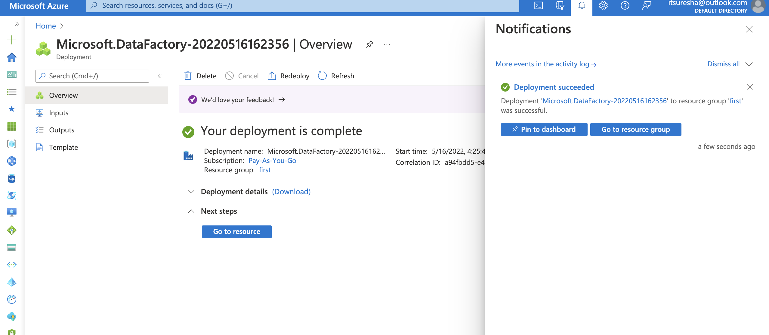
Copy Activity

Slide 21
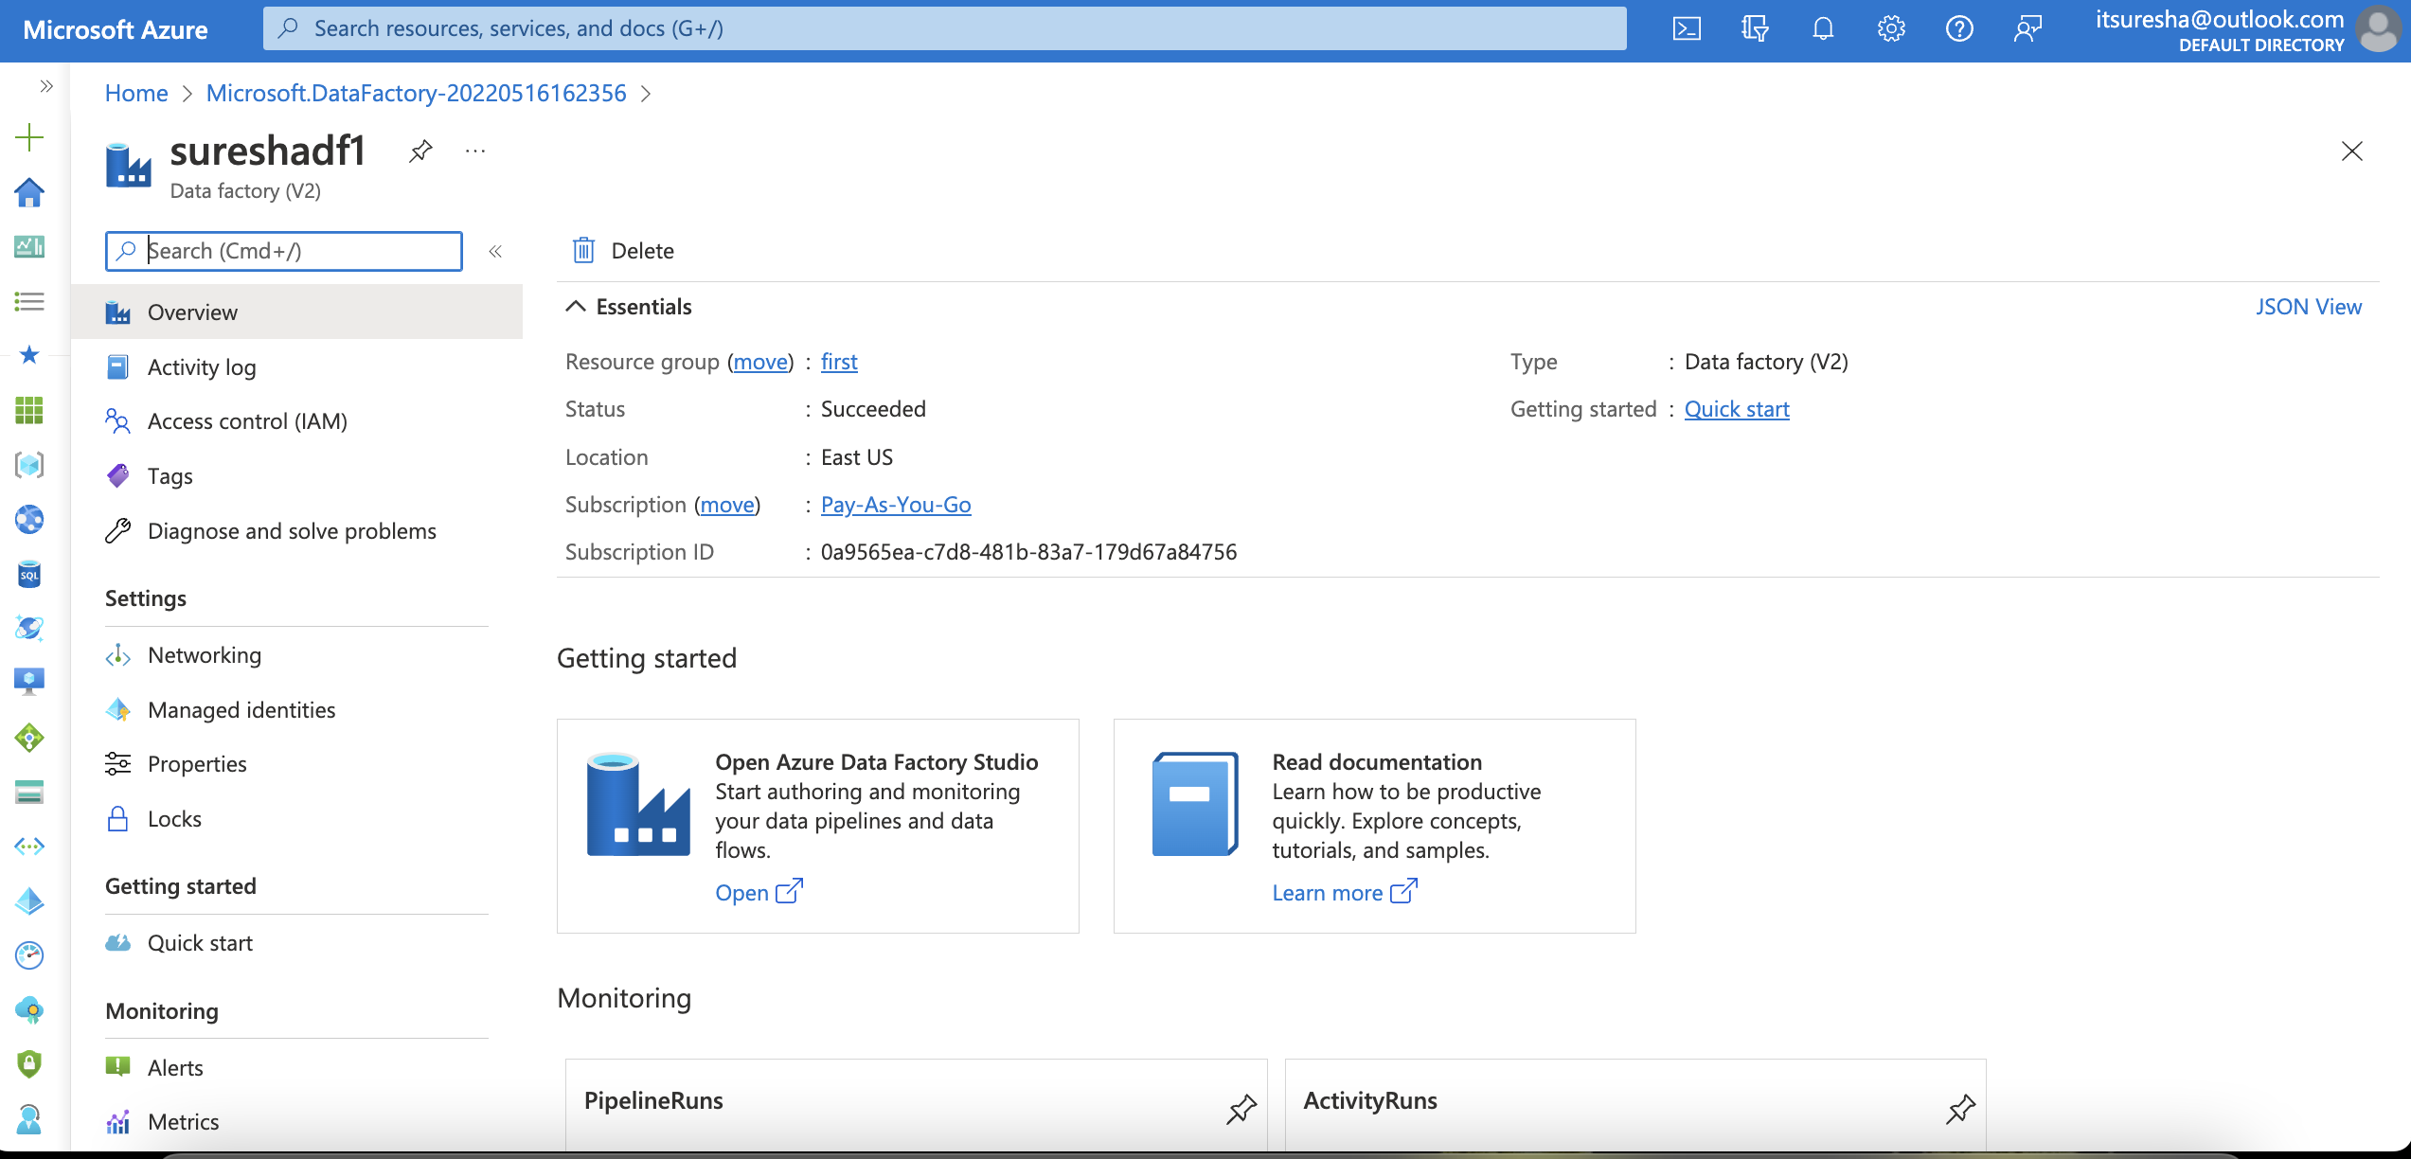
Copy Activity

Slide 22
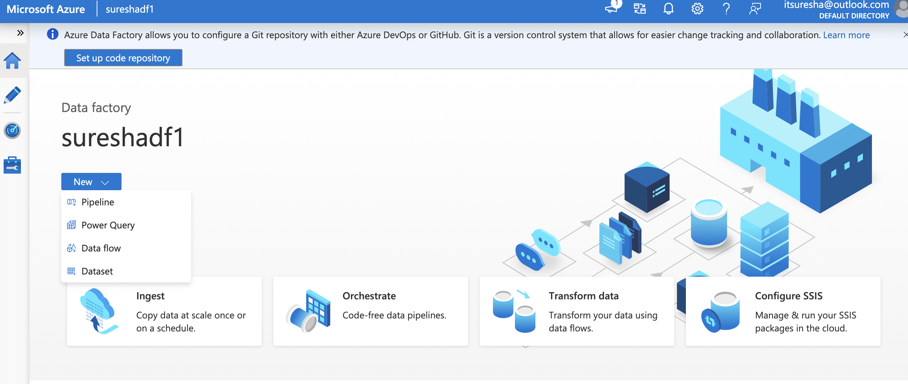
Copy Activity

Slide 23
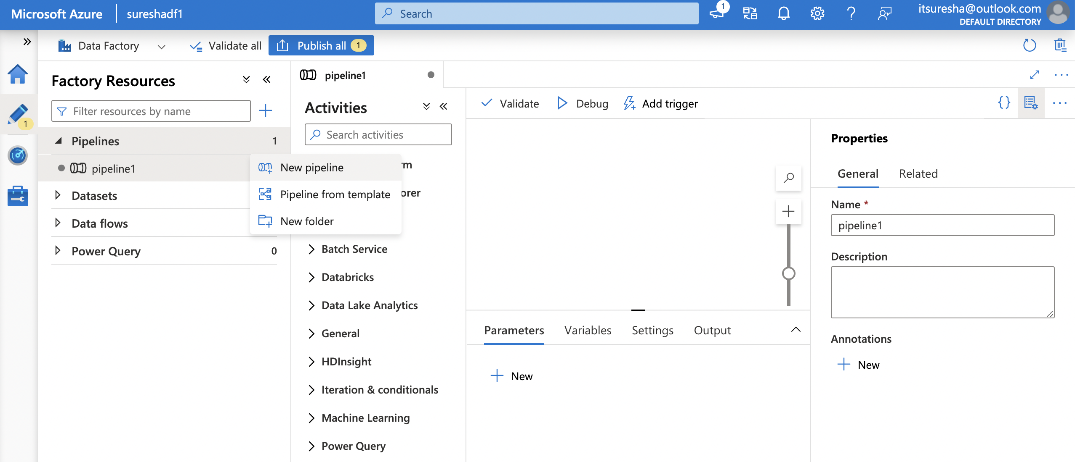
Copy Activity

Slide 24
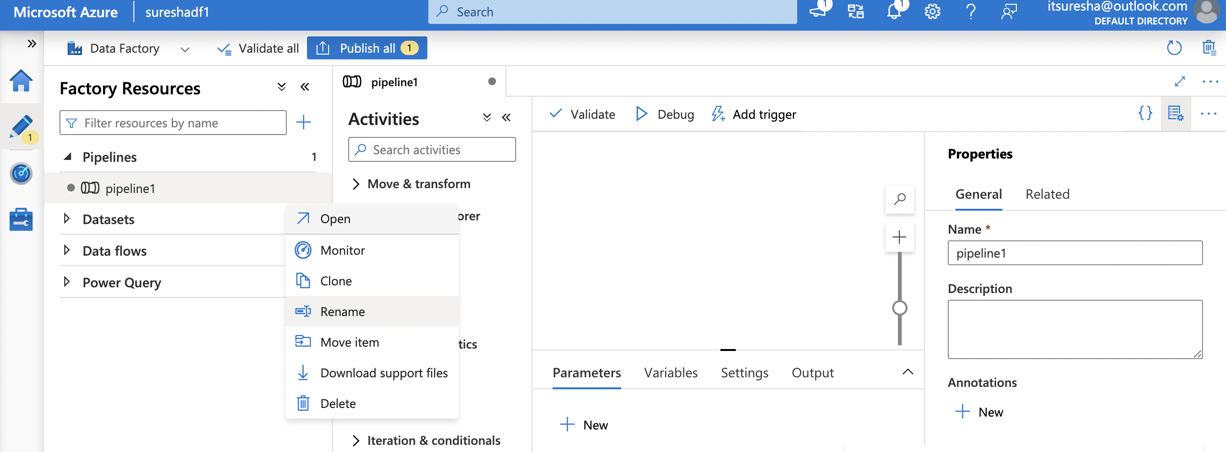
Copy Activity

Slide 25
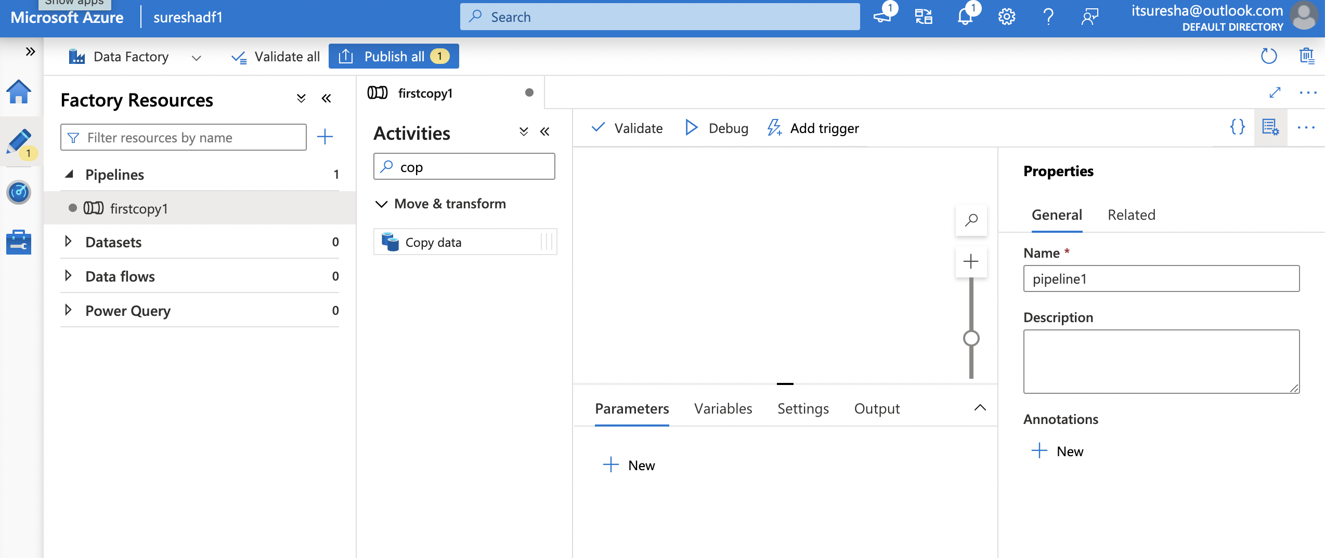
Copy Activity

Slide 26
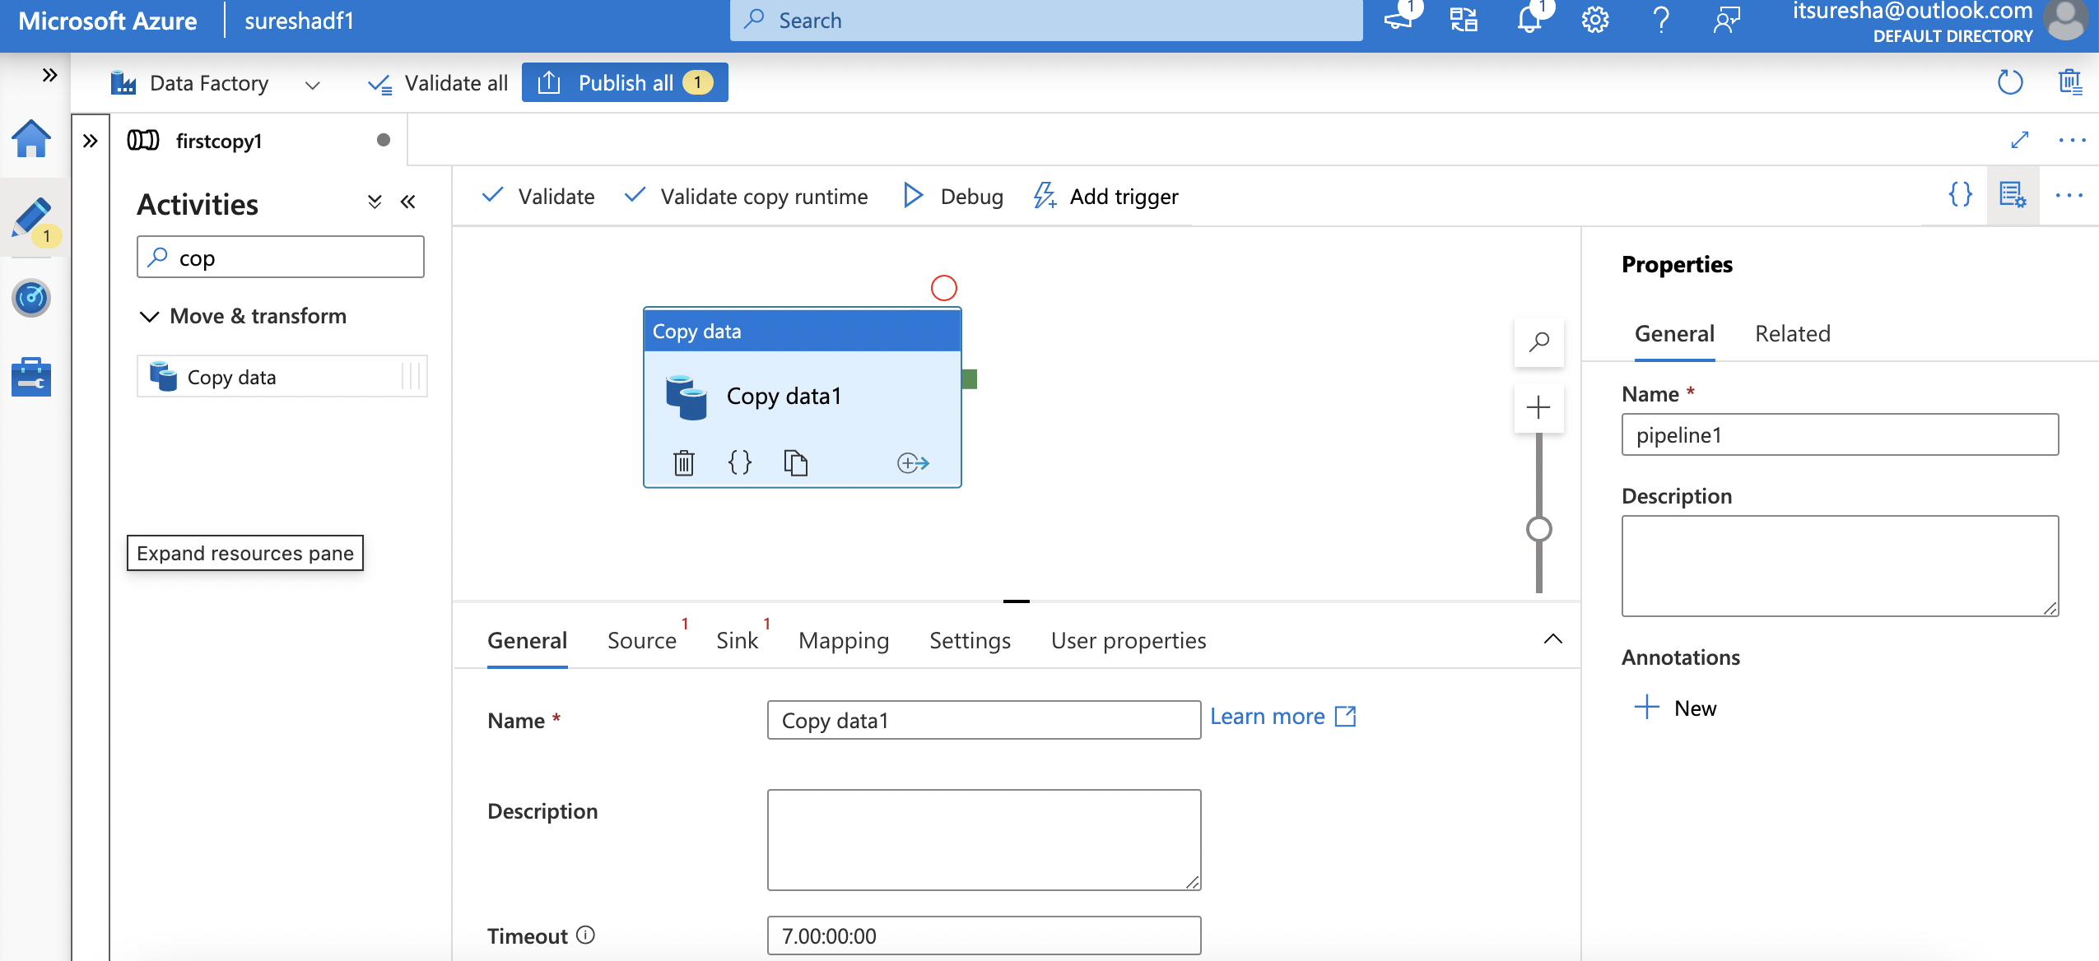
Copy Activity

Slide 27
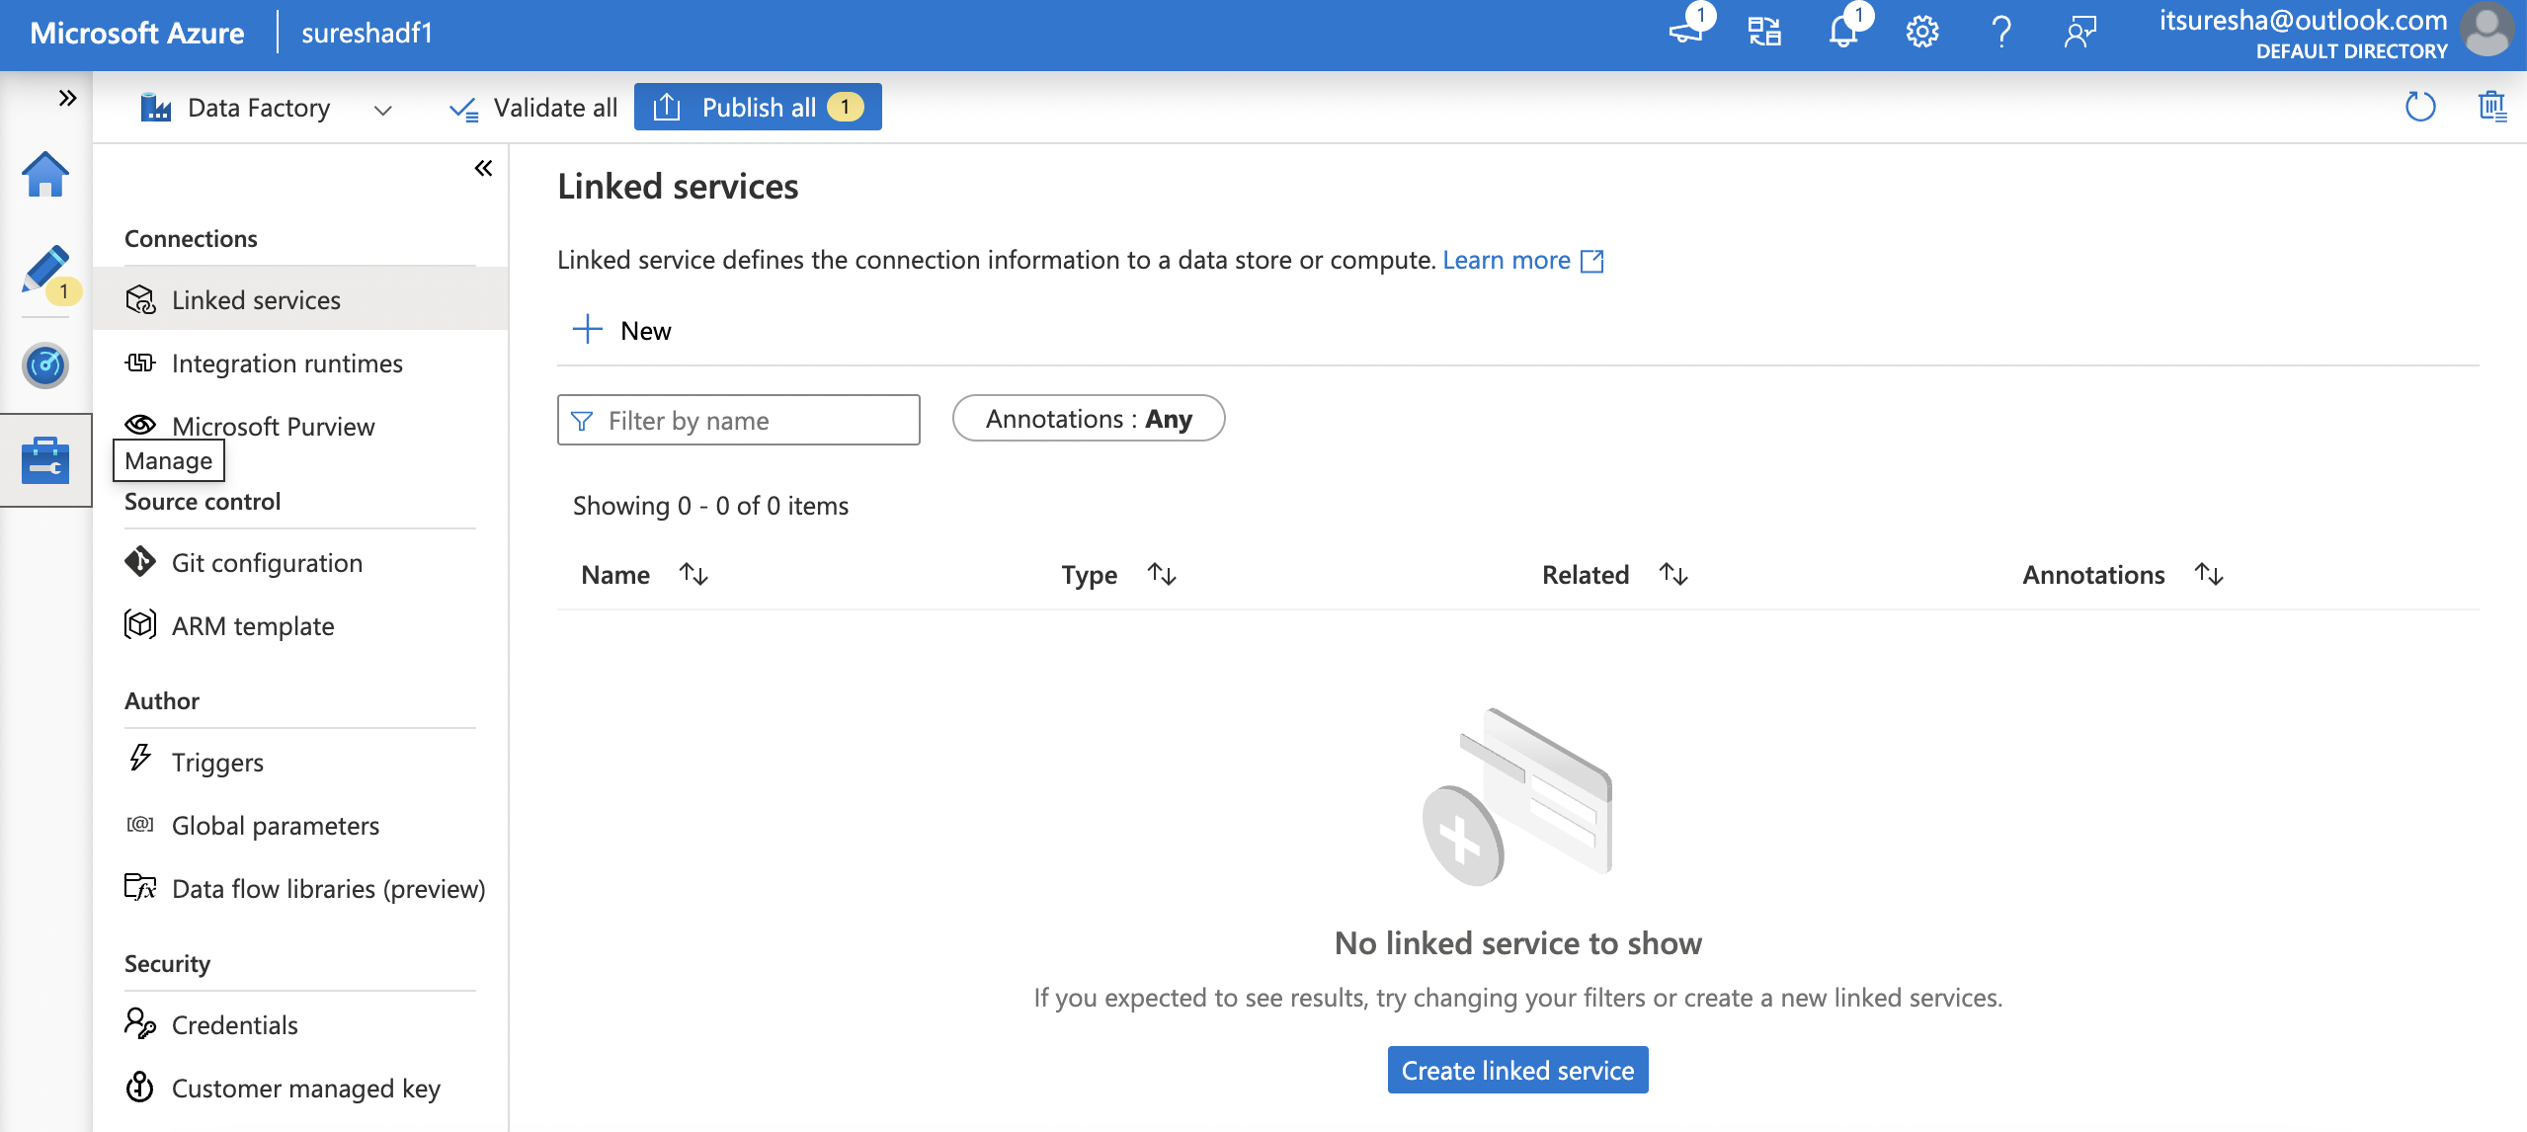
Copy Activity

Slide 28
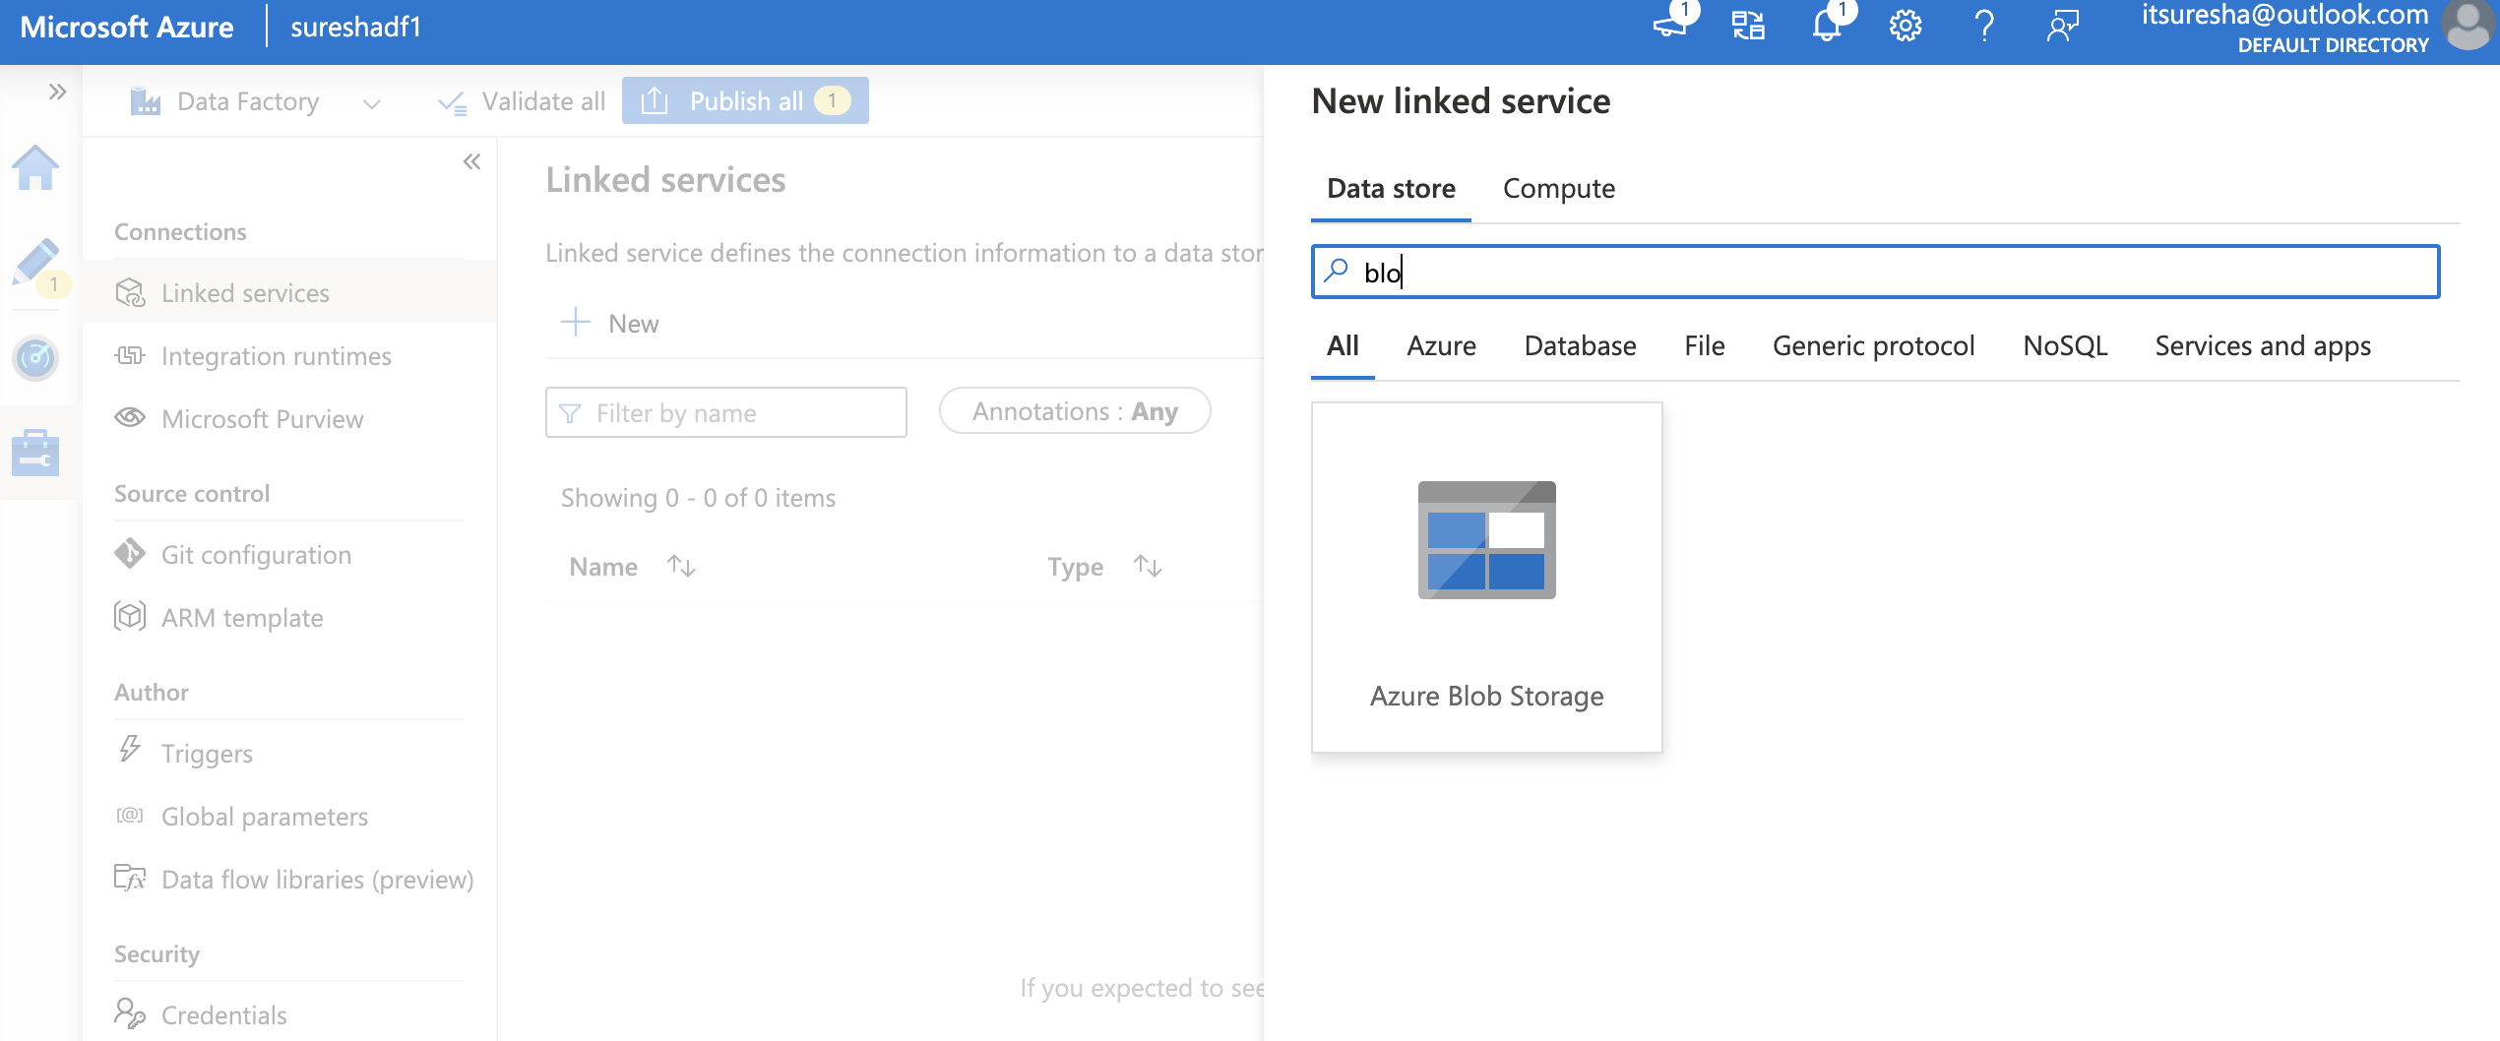
Copy Activity

Slide 29
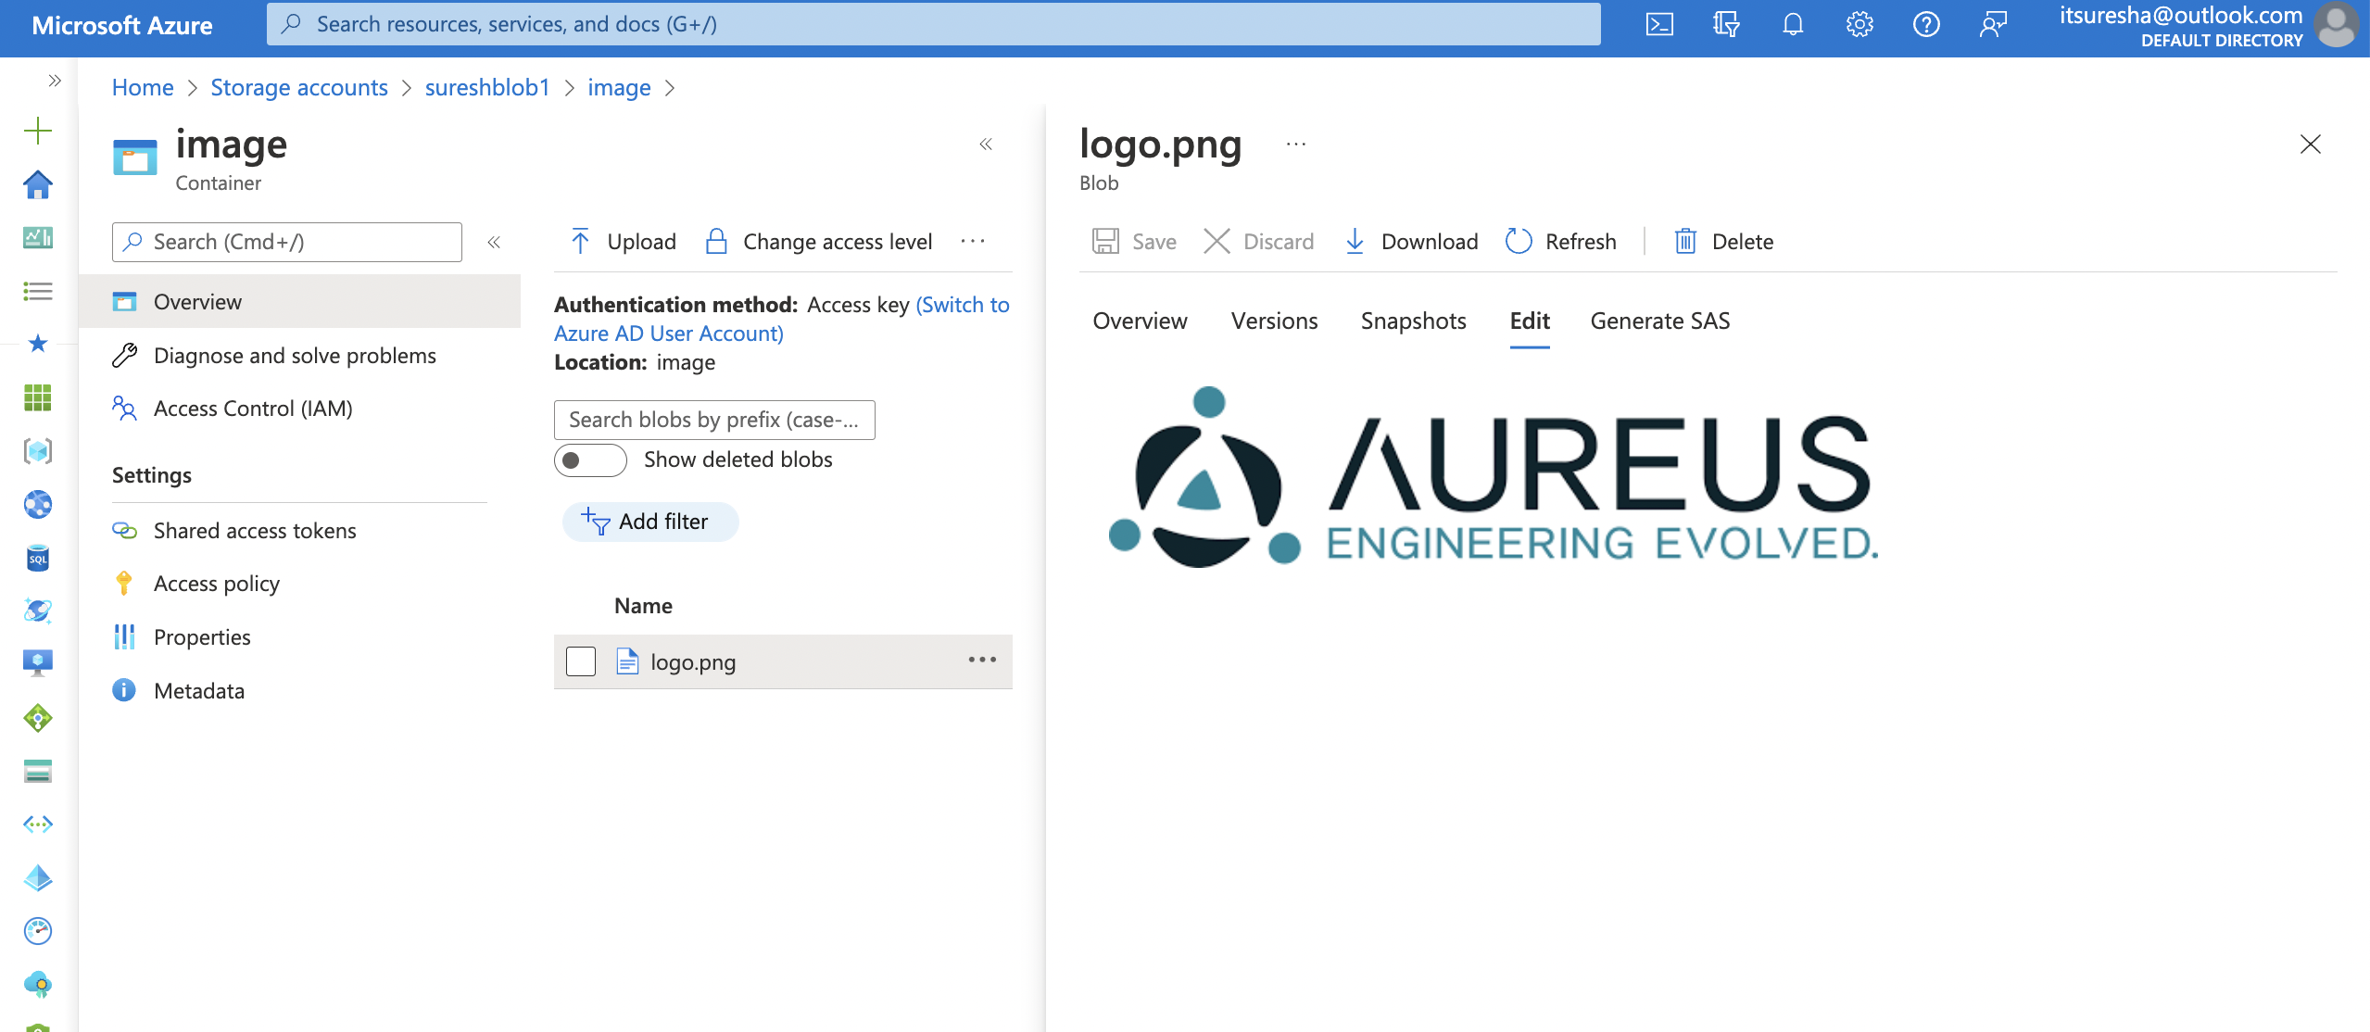
Copy Activity

Slide 30
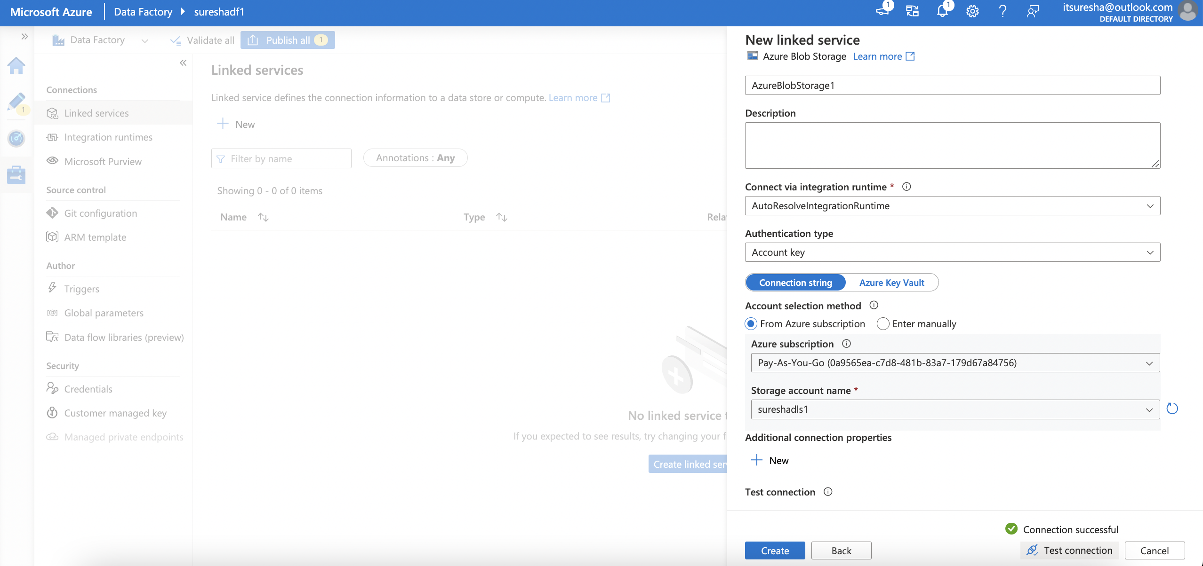
Copy Activity

Slide 31
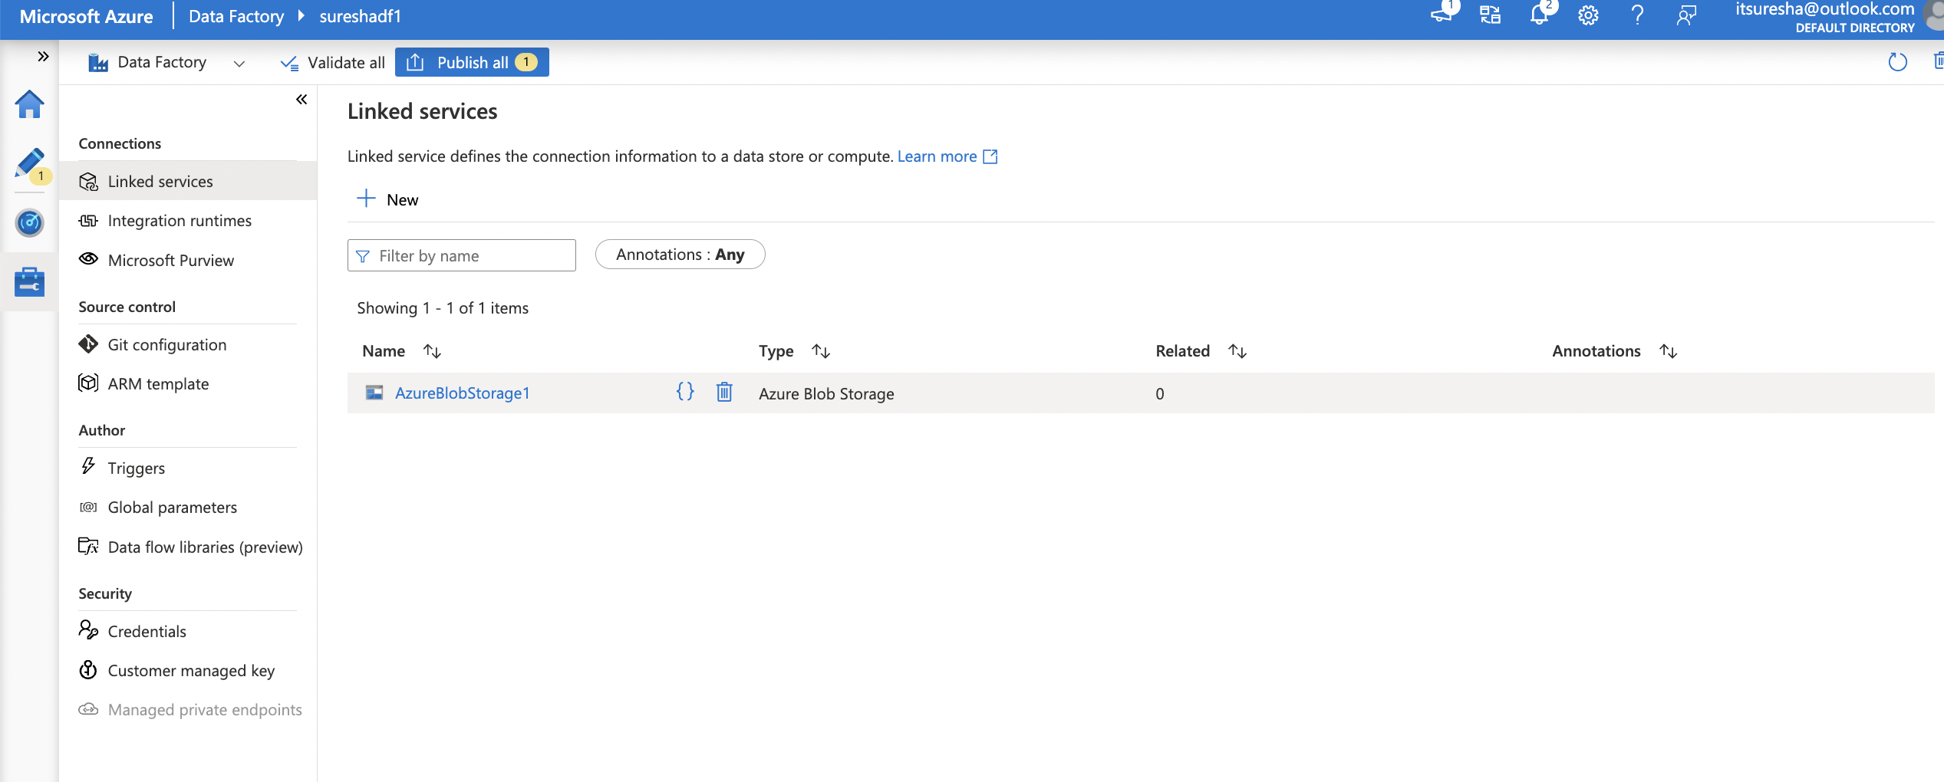
Copy Activity

Slide 32
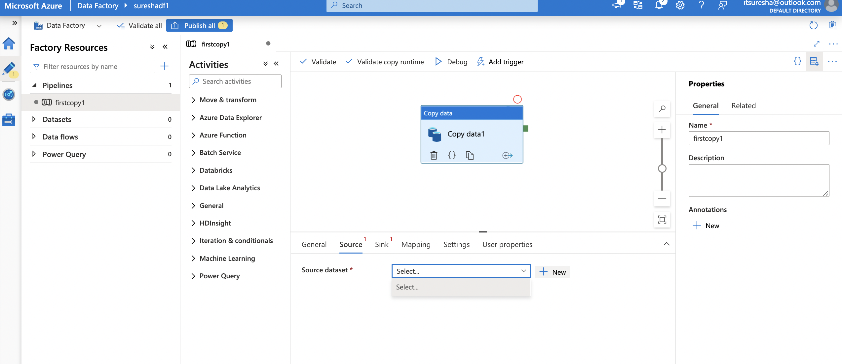
Copy Activity

Slide 33
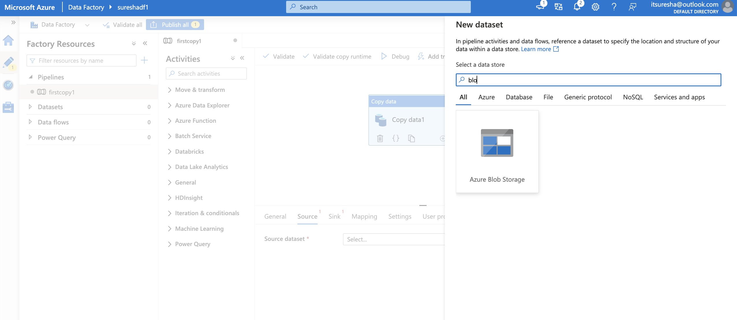
Copy Activity

Slide 34
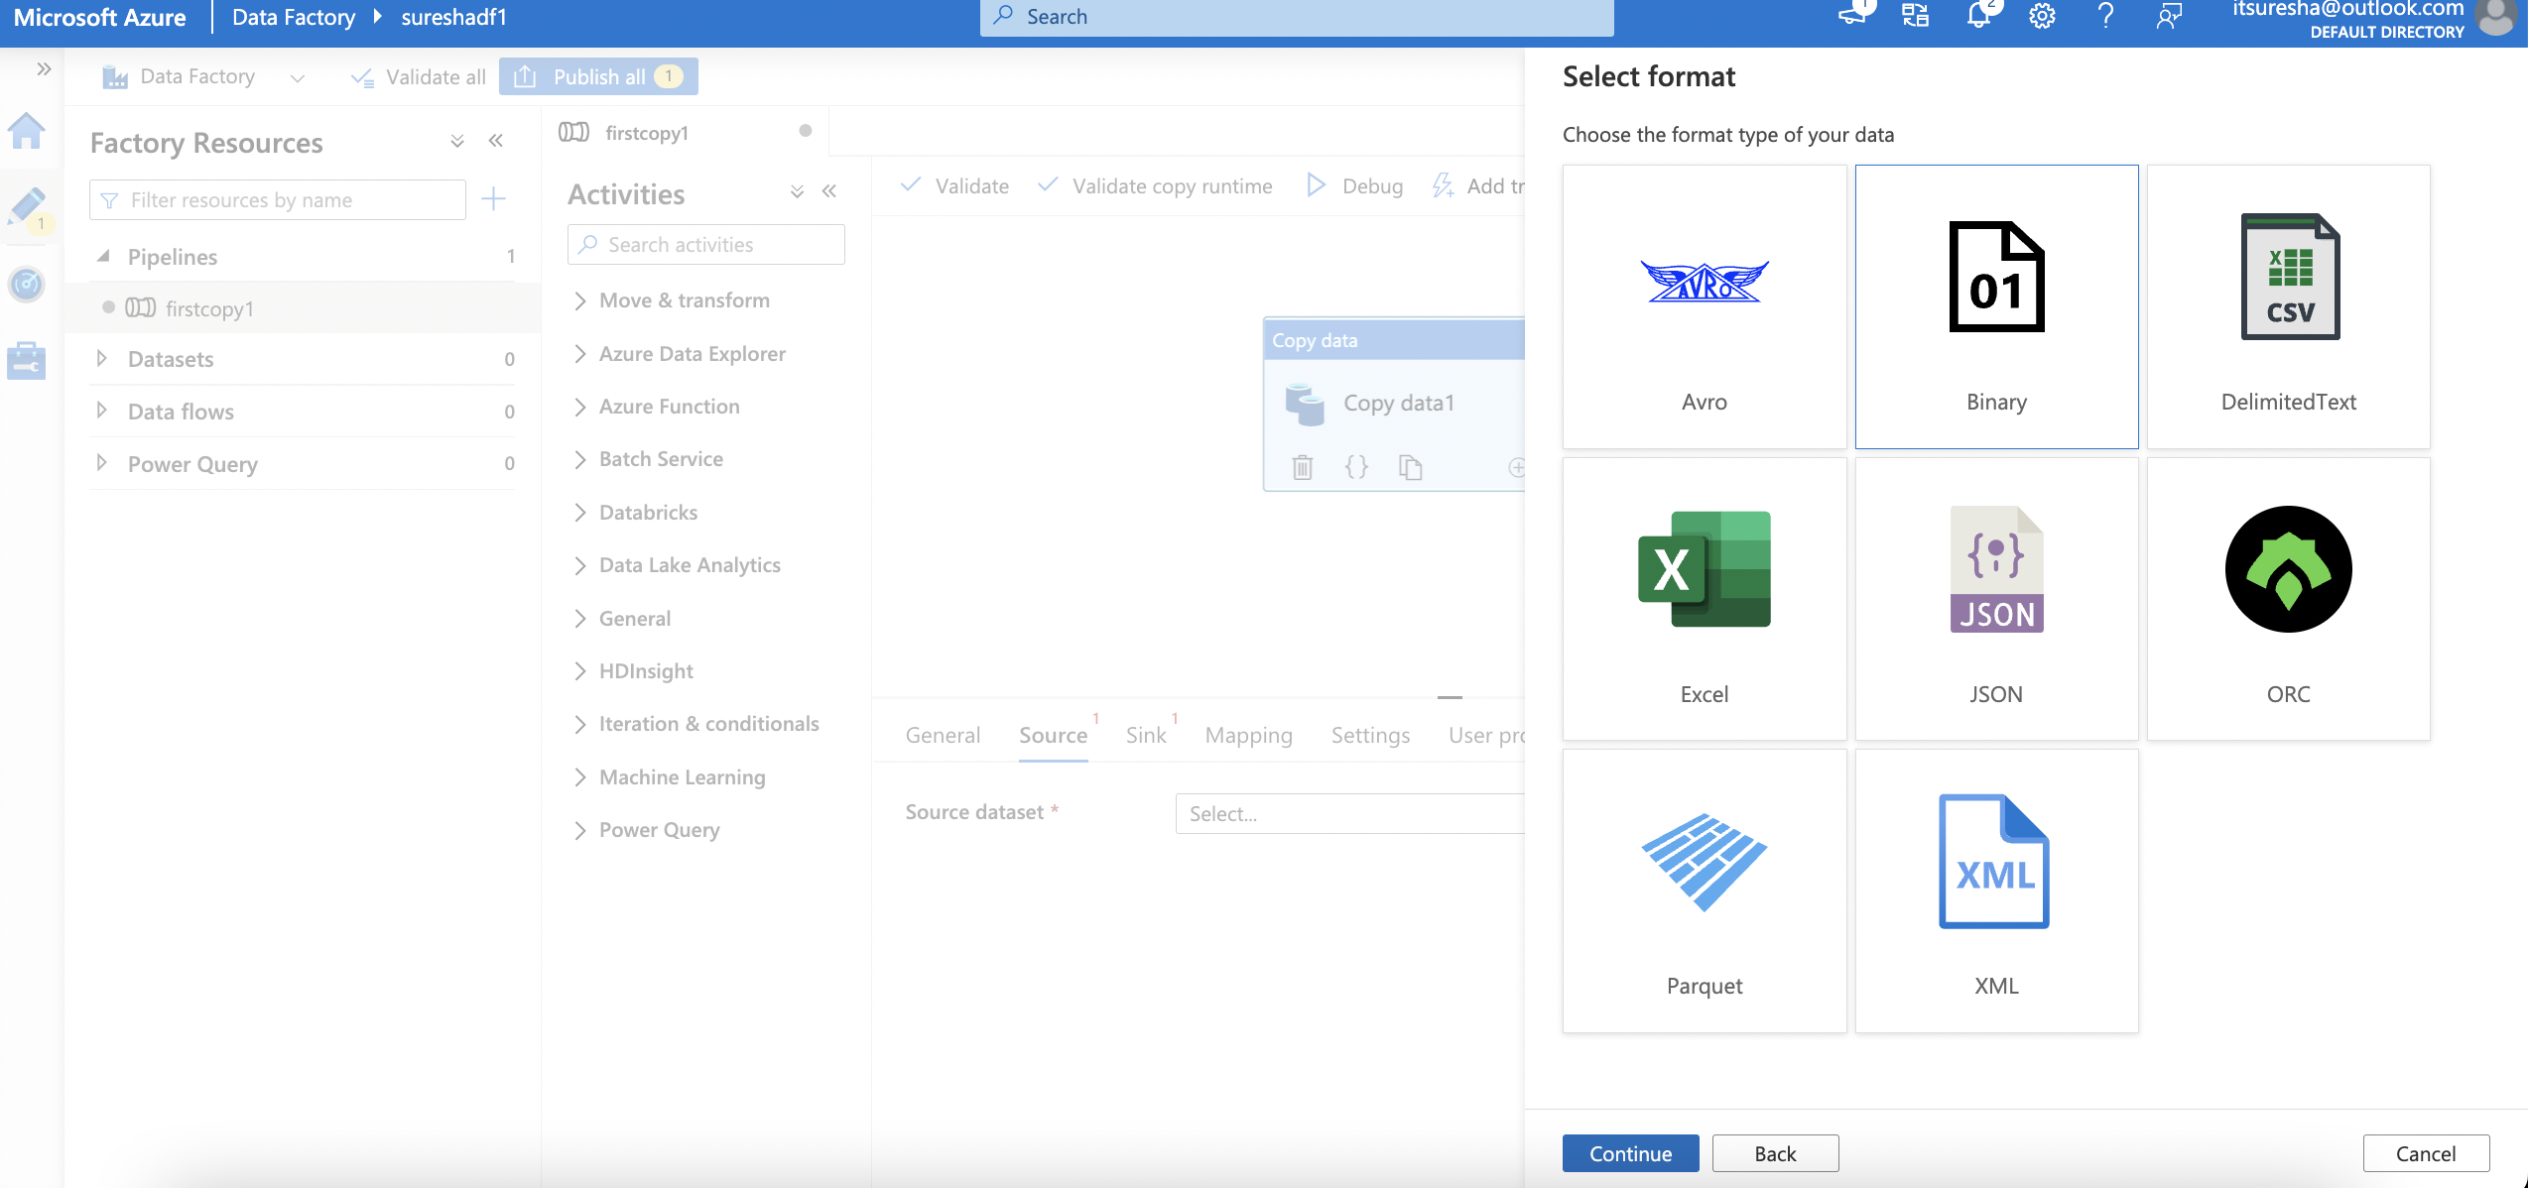
Copy Activity

Slide 35
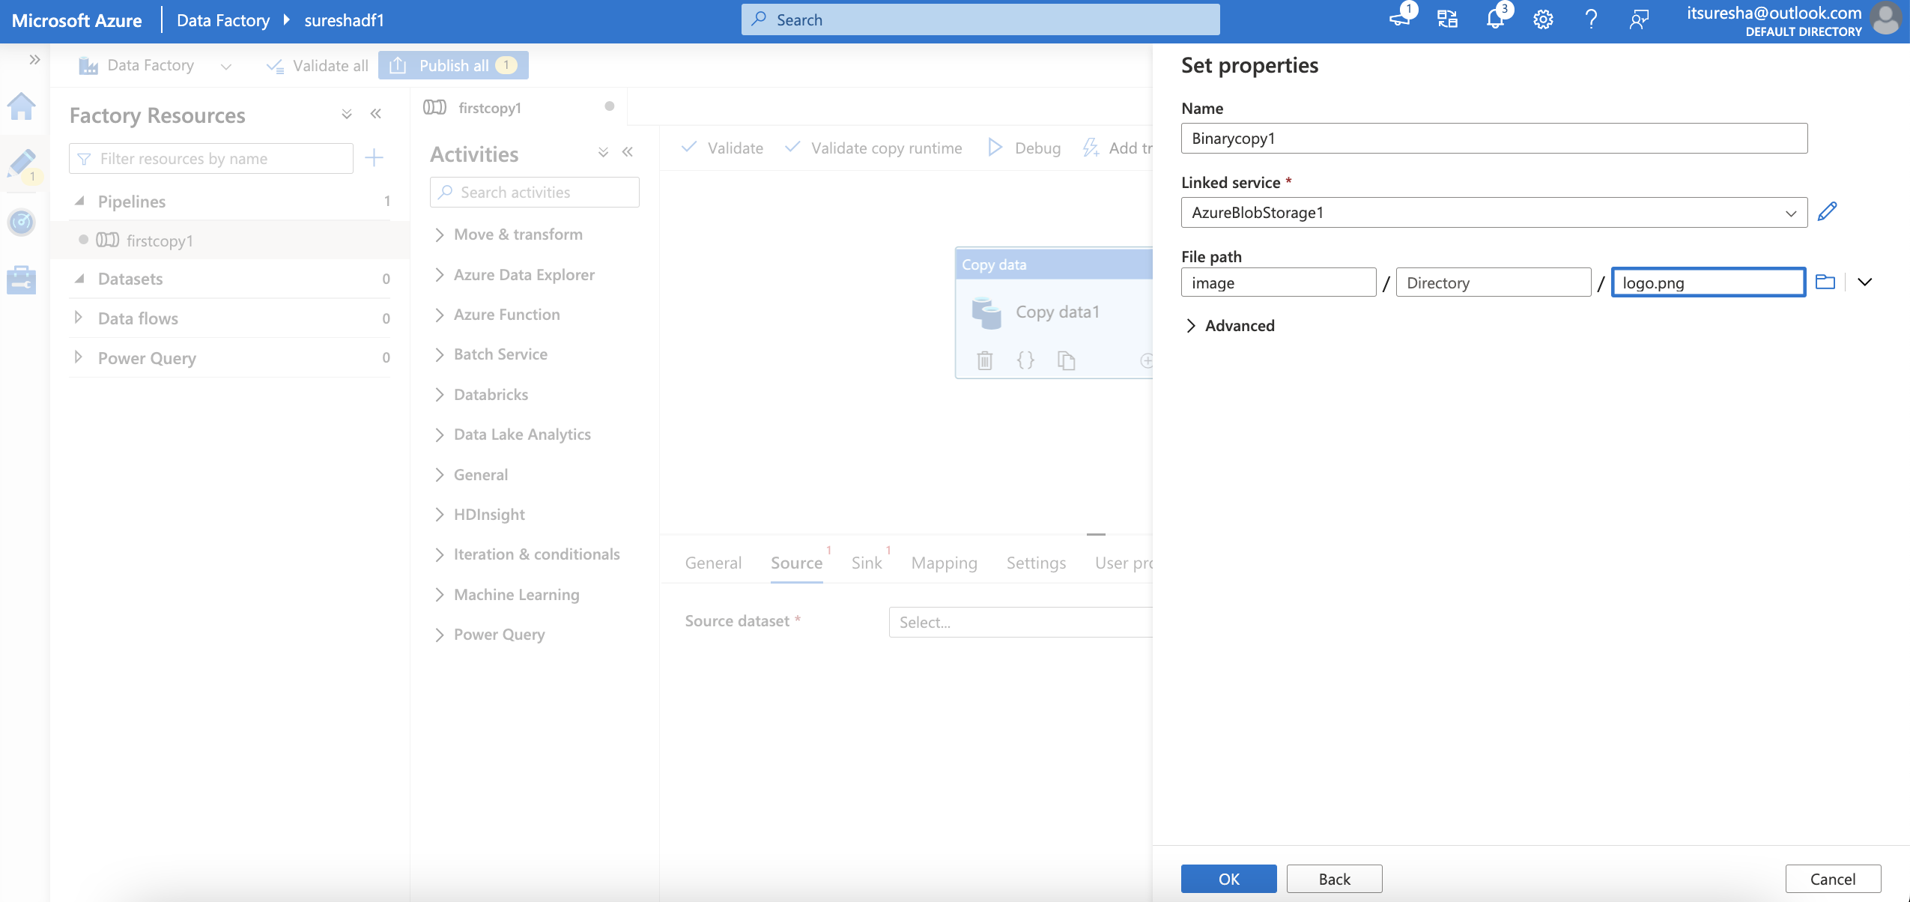
Copy Activity

Slide 36
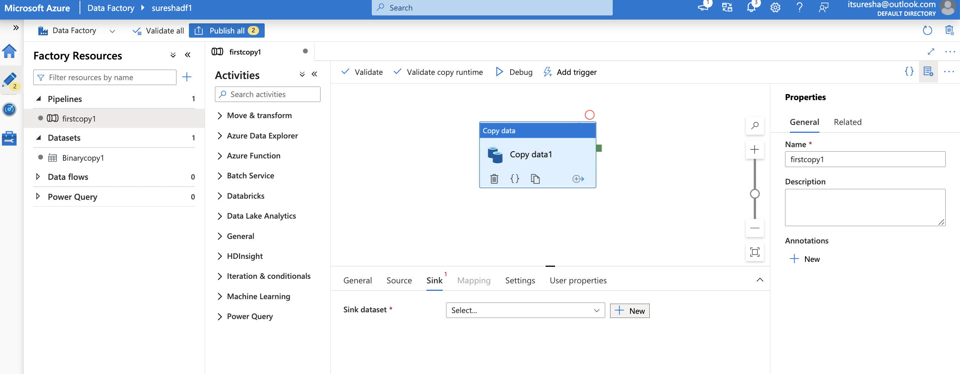
Copy Activity

Slide 37
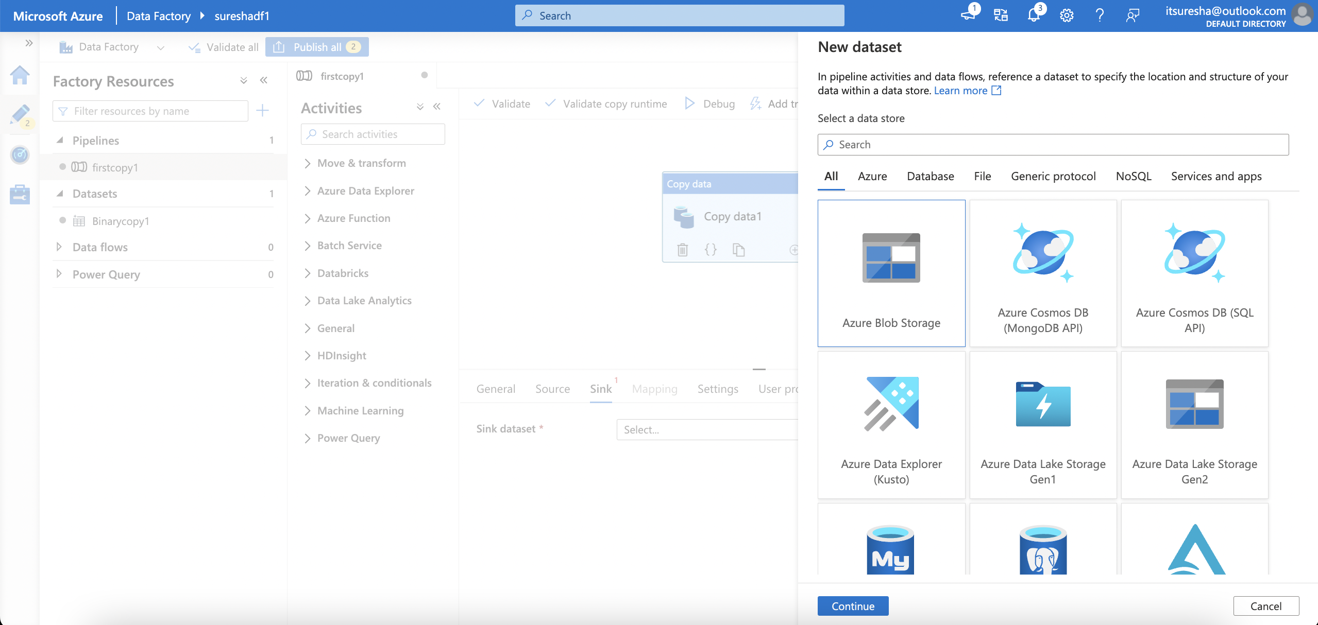
Copy Activity

Slide 38
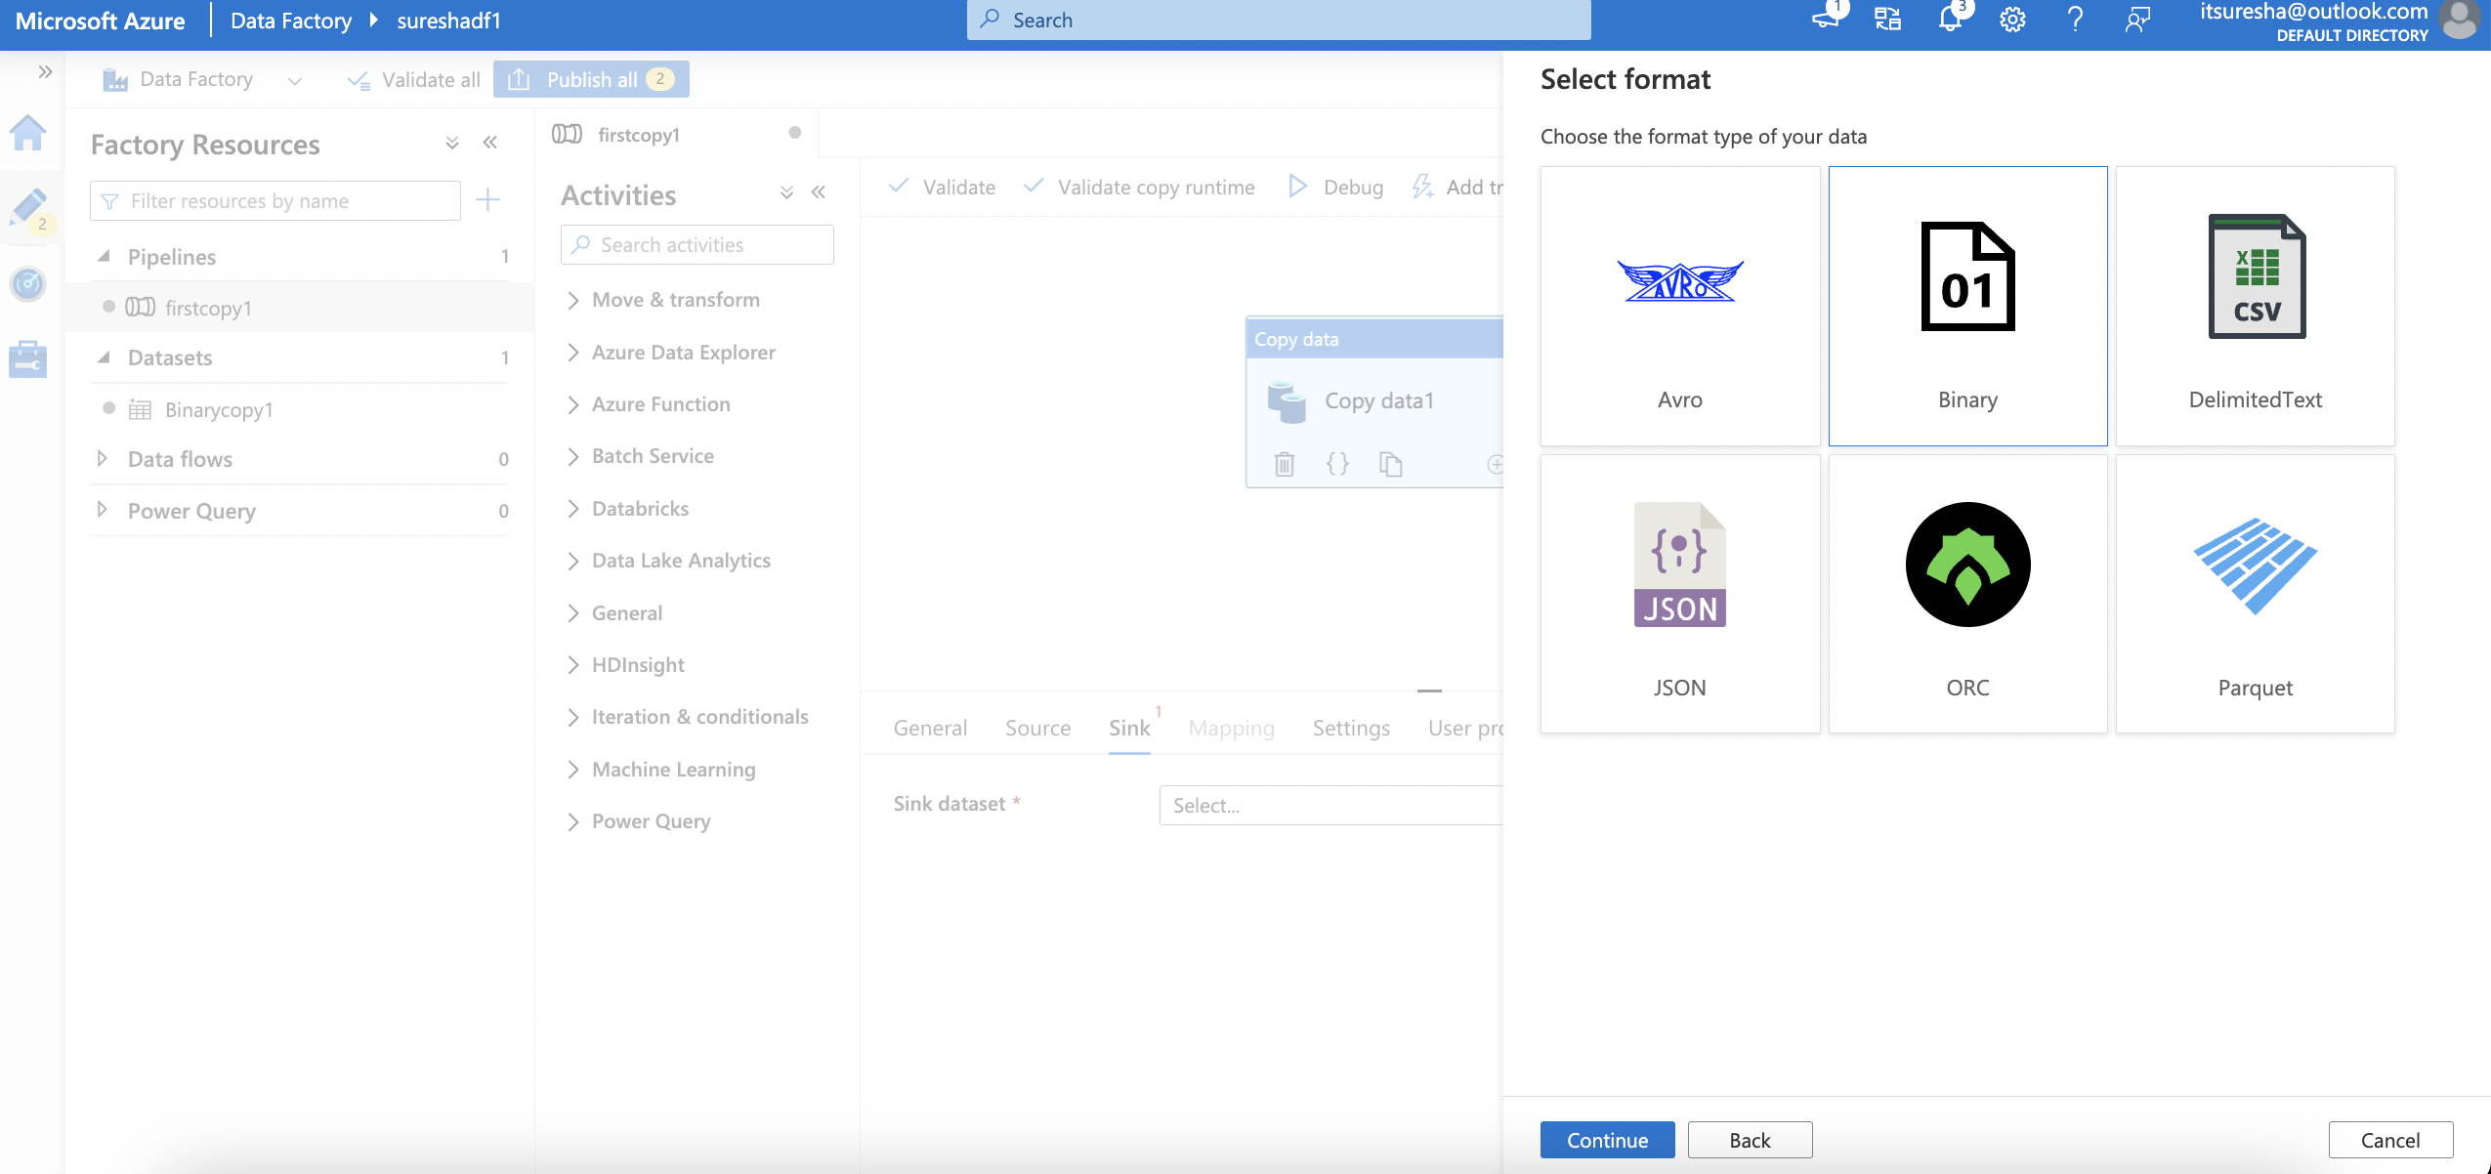
Copy Activity

Slide 39
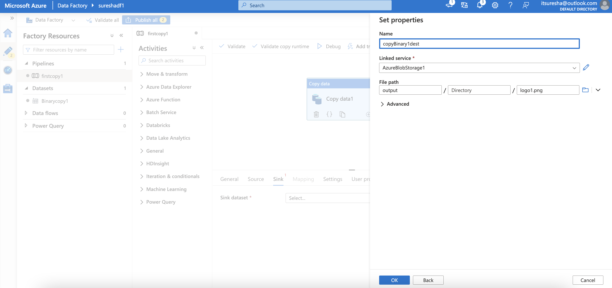
Copy Activity

Slide 40
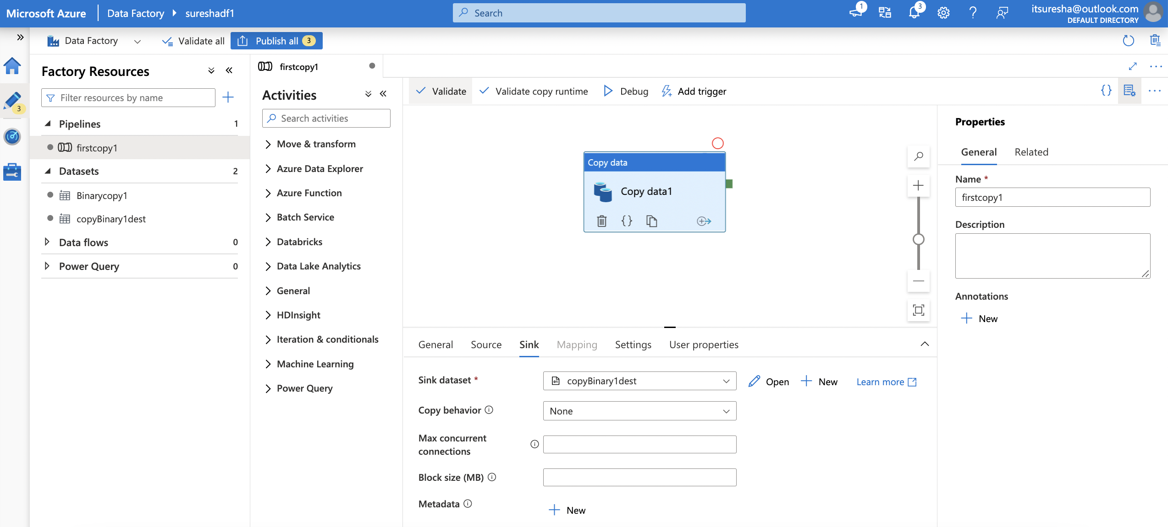
Copy Activity

Slide 41
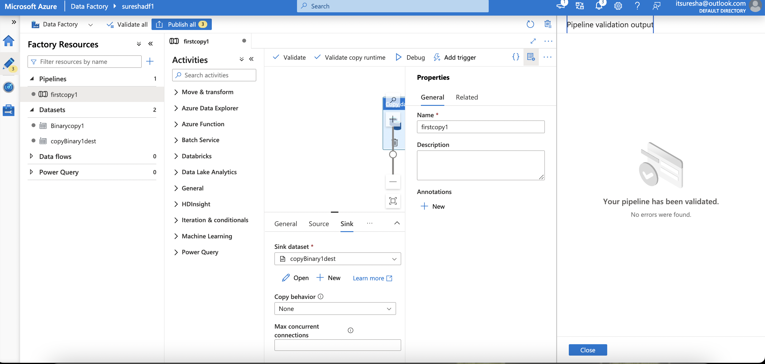
Copy Activity

Slide 42
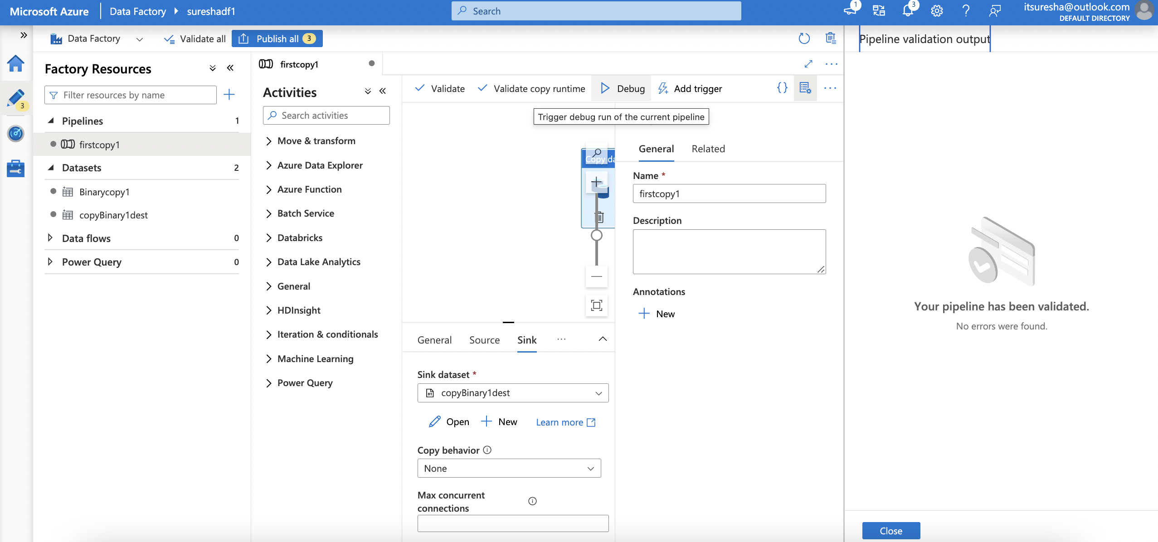
Copy Activity

Slide 43
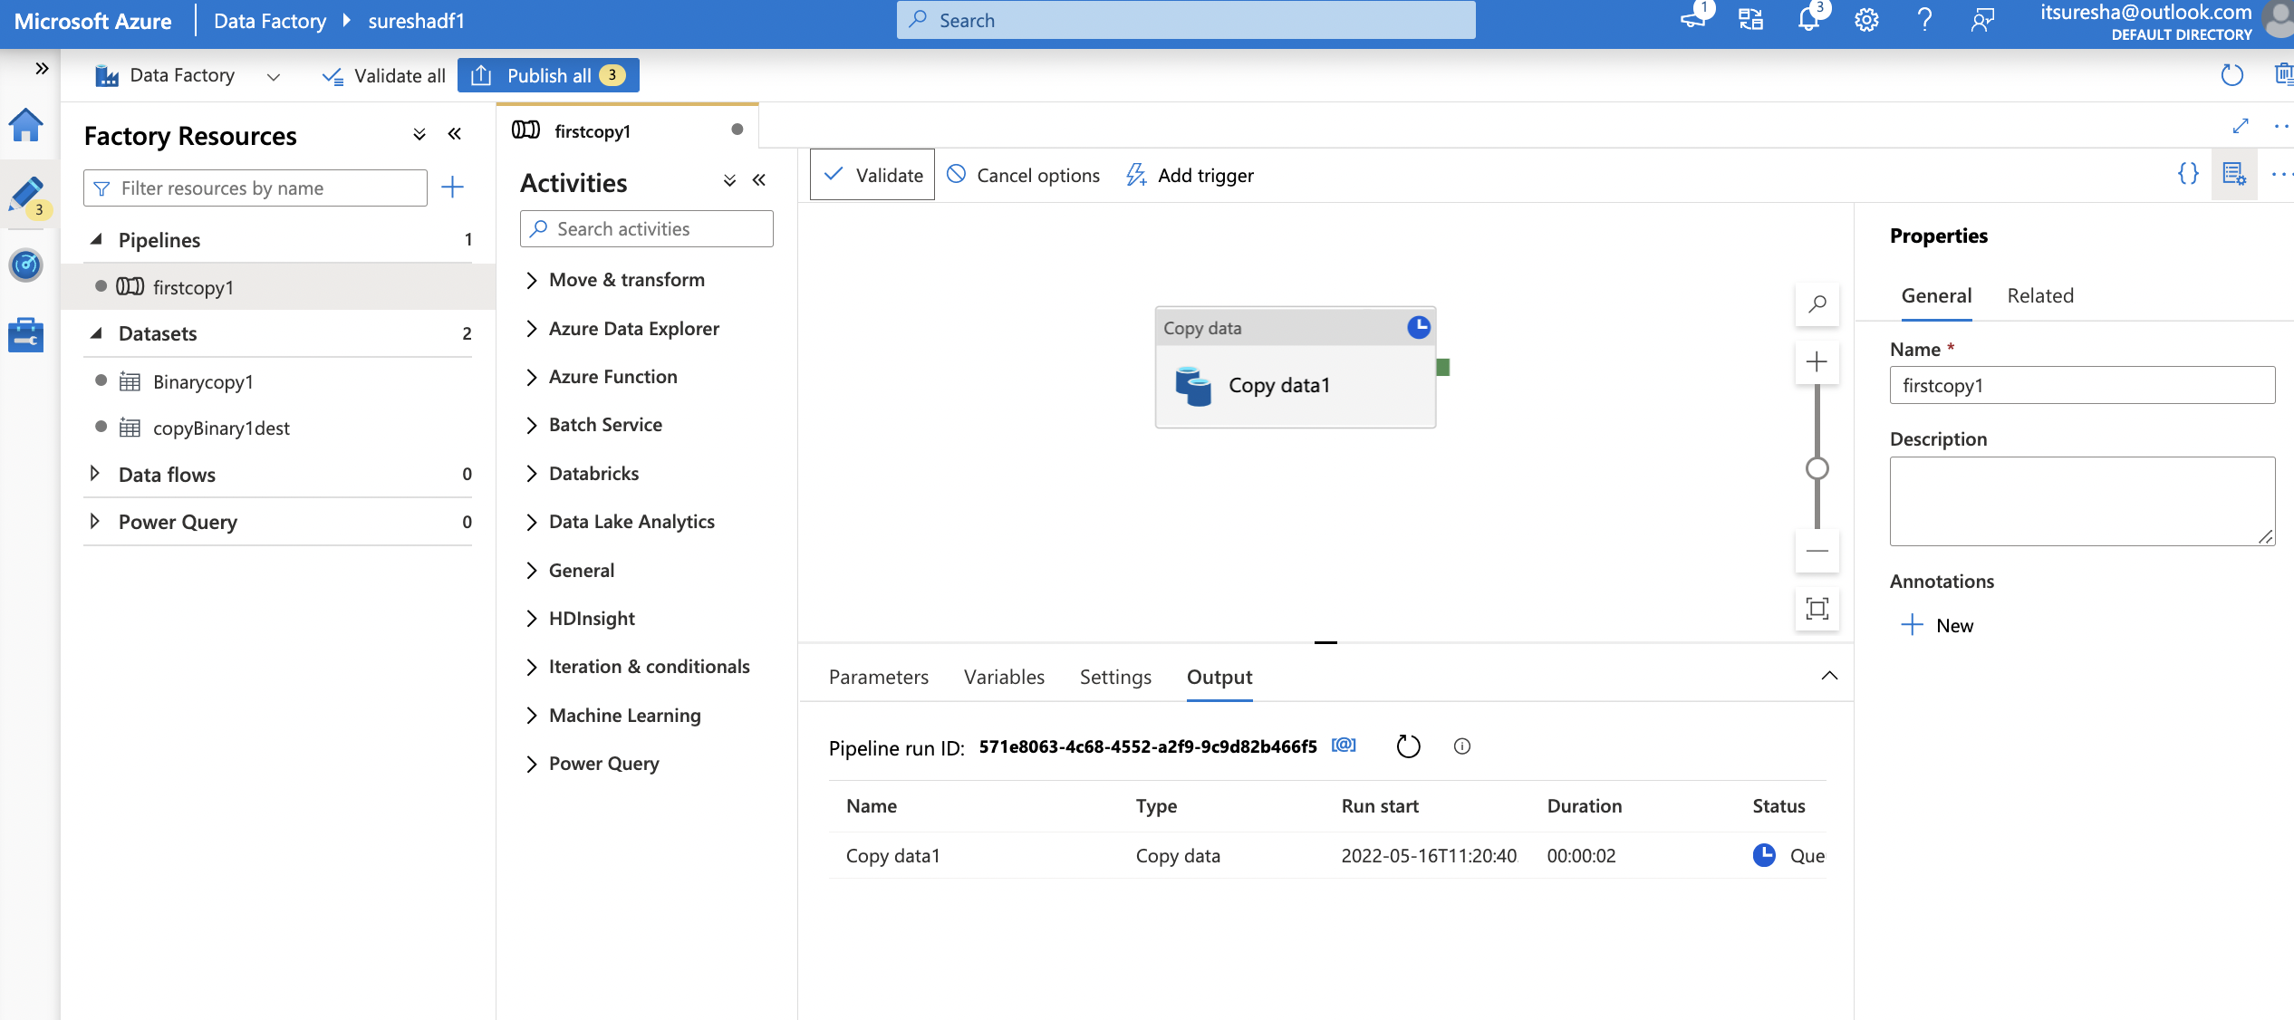
Copy Activity

Slide 44
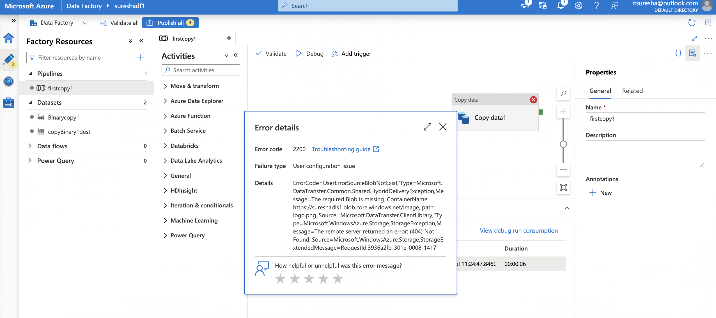
Copy Activity

Slide 45
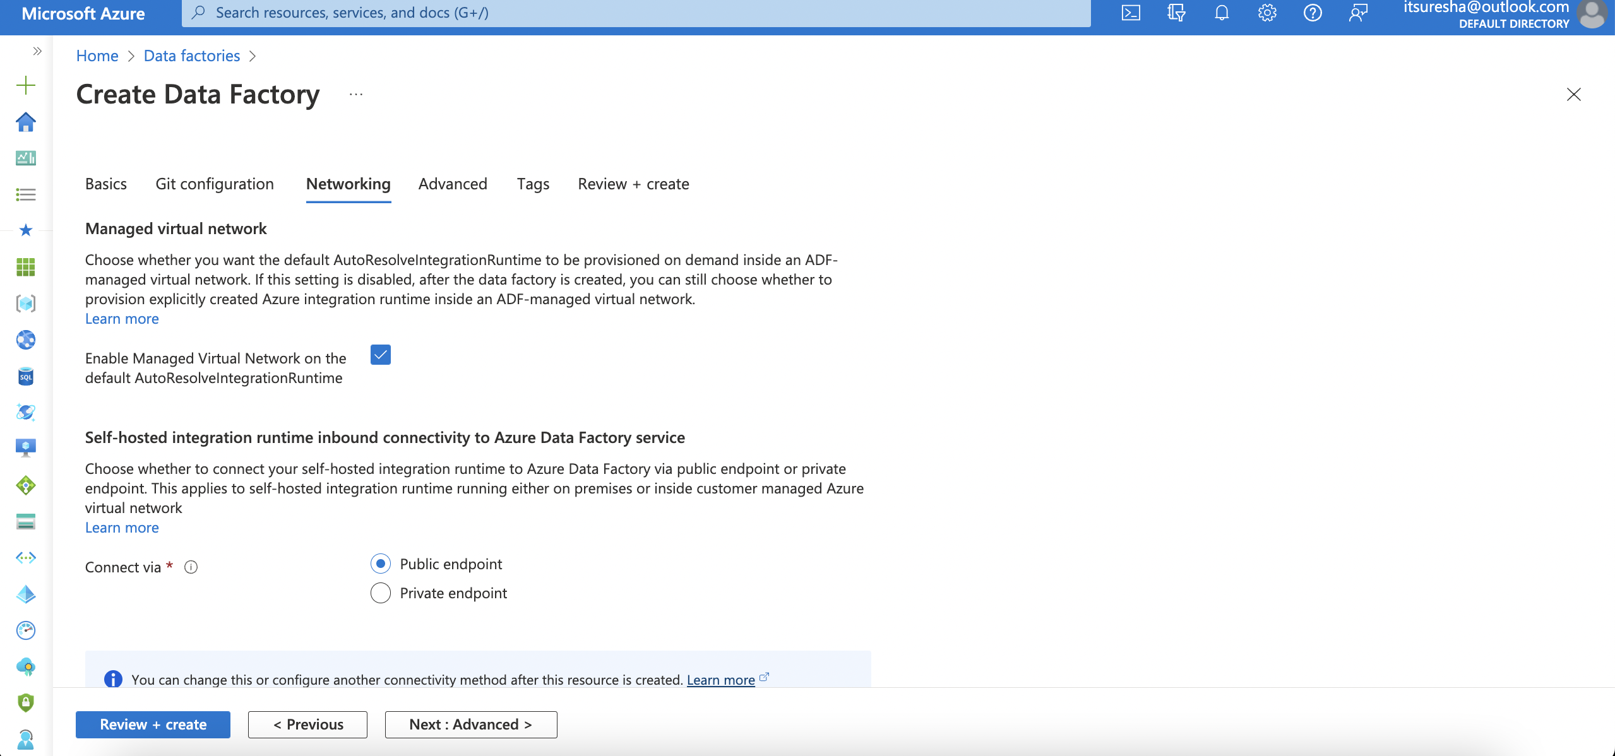
Copy Activity

Slide 46
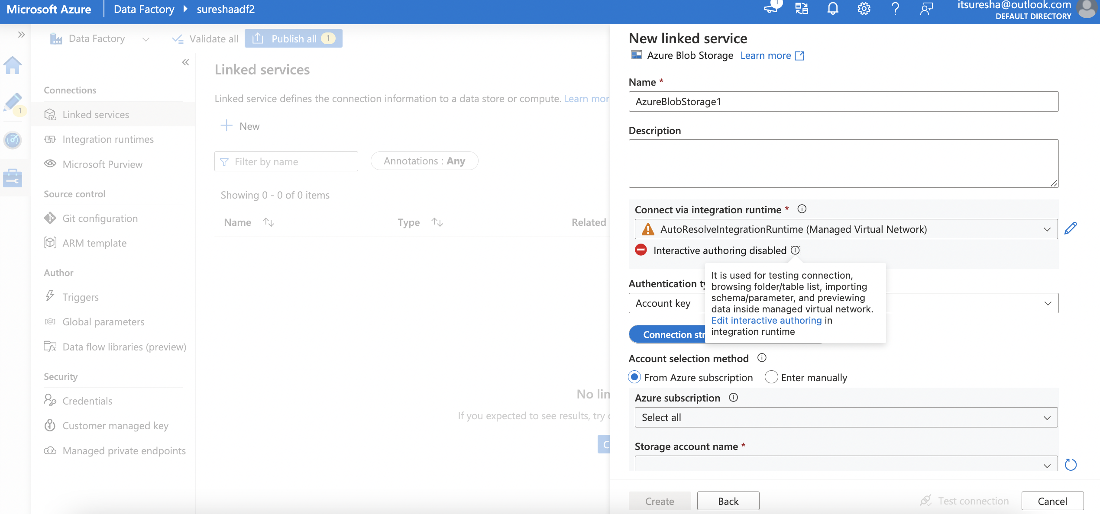
Copy Activity

Slide 47
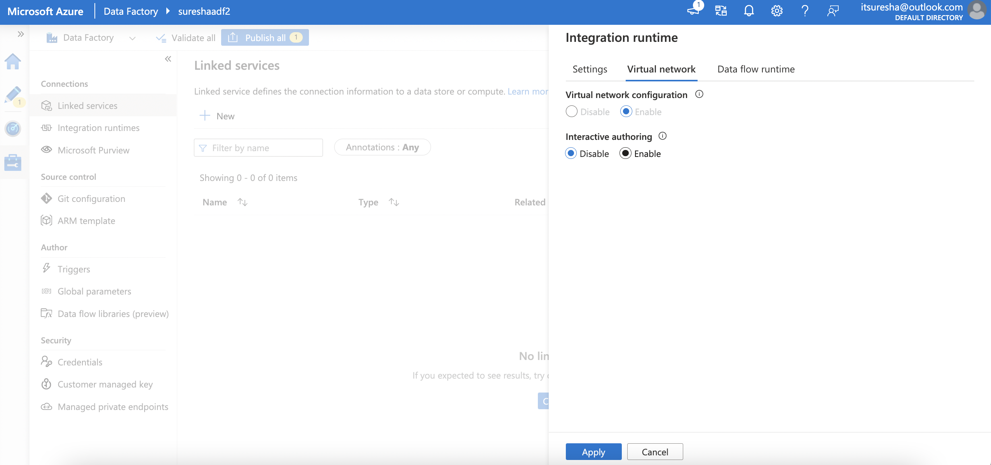
Copy Activity

Slide 48
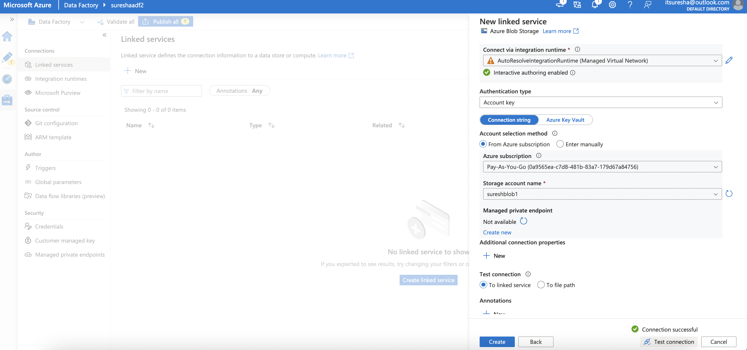
Copy Activity

Slide 49
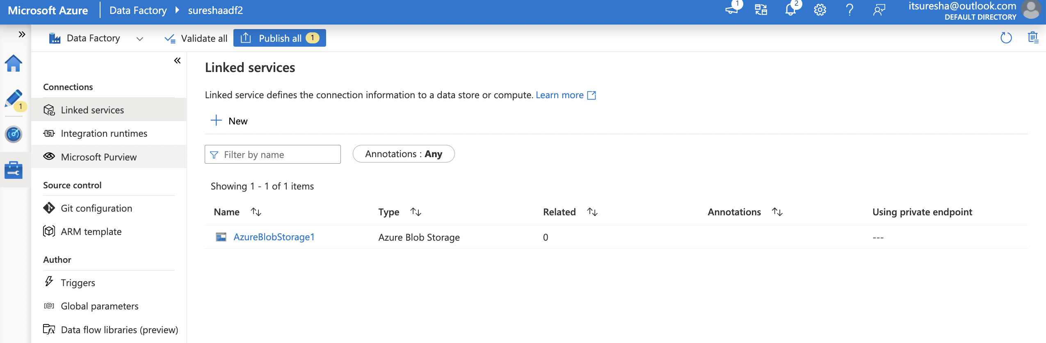
Copy Activity

Slide 50
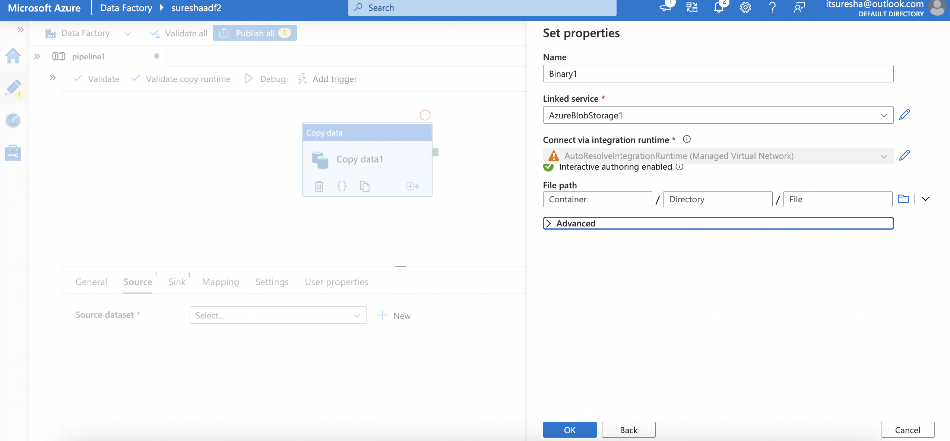
Copy Activity

Slide 51
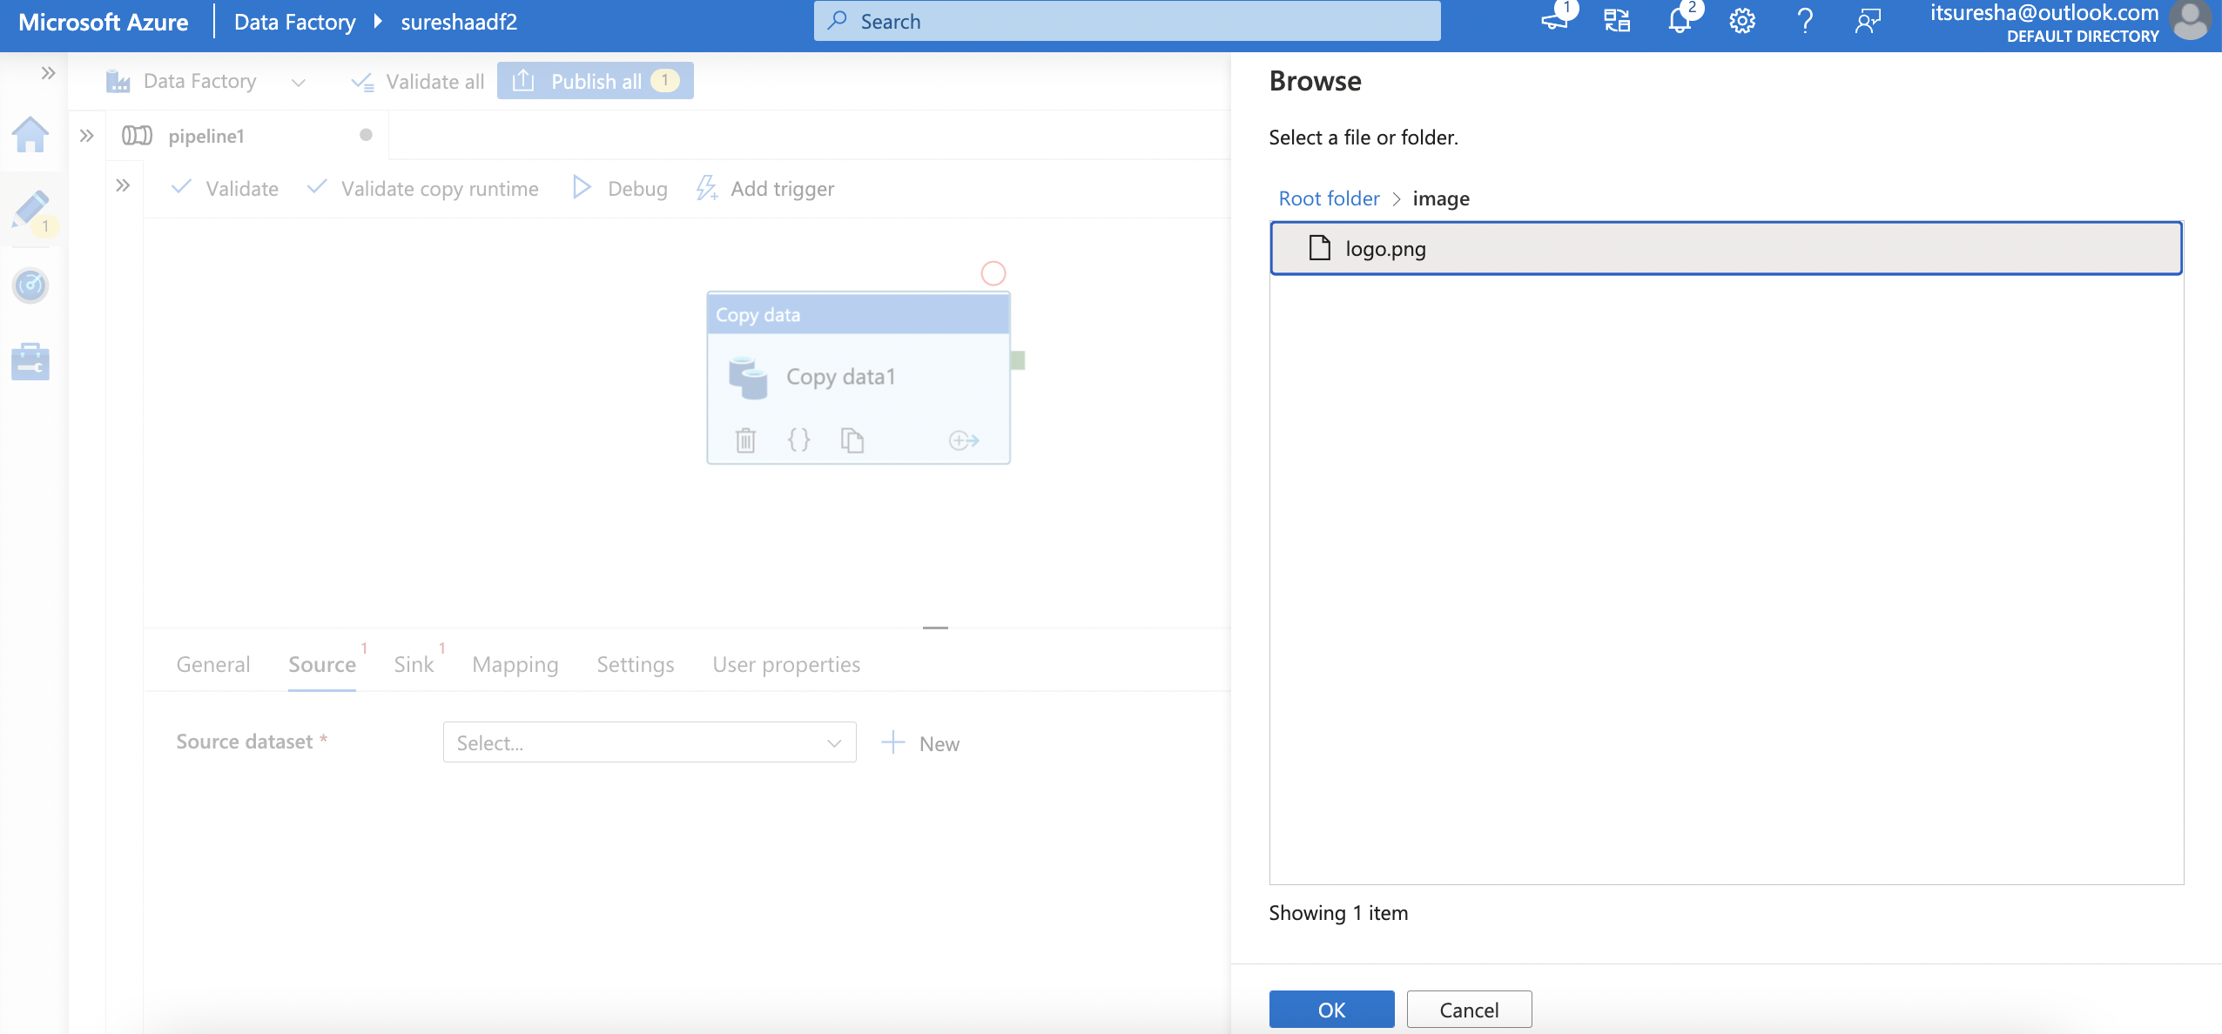
Copy Activity

Slide 52
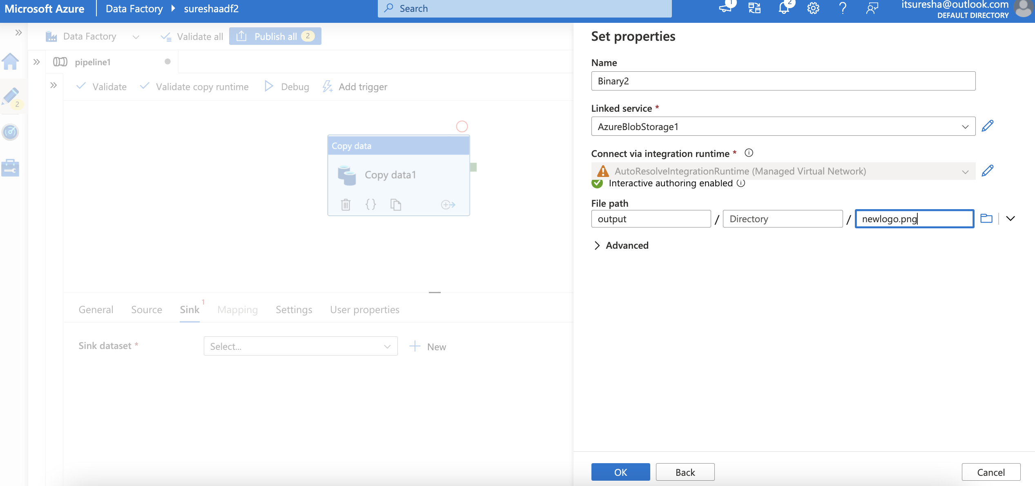
Copy Activity

Slide 53
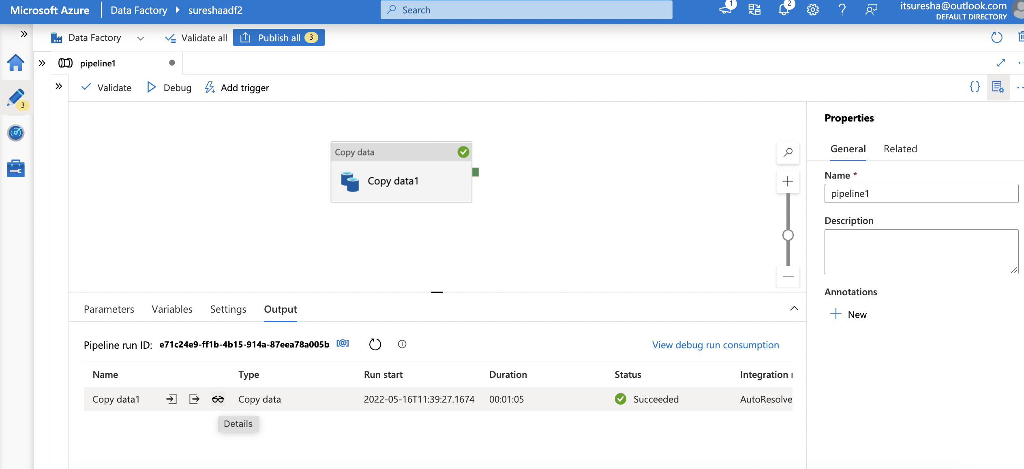
Copy Activity

Slide 54

Copy Activity

Slide 55
Types of Trigger
Scheduled
Tumbling Window
Event

Slide 56

Scheduled Trigger

Slide 57

Scheduled Trigger

Slide 58

Scheduled Trigger

Slide 59

Scheduled Trigger

Slide 60

Scheduled Trigger

Slide 61

Scheduled Trigger

Slide 62

Scheduled Trigger

Slide 63

Scheduled Trigger

Slide 64

Scheduled Trigger

Slide 65

Scheduled Trigger

Slide 66

Scheduled Trigger

Slide 67
Tumbling vs Schedule
Item | Tumbling window trigger | Schedule trigger
Backfill scenarios | Supported. Pipeline runs can be scheduled for windows in the past. | Not supported. Pipeline runs can be executed only on time periods from the current time and the future.
Reliability | 100% reliability. Pipeline runs can be scheduled for all windows from a specified start date without gaps. | Less reliable.
Retry capability | Supported. Failed pipeline runs have a default retry policy of 0, or a policy that's specified by the user in the trigger definition. Automatically retries when the pipeline runs fail due to concurrency/server/throttling limits (that is, status codes 400: User Error, 429: Too many requests, and 500: Internal Server error). | Not supported.
Concurrency | Supported. Users can explicitly set concurrency limits for the trigger. Allows between 1 and 50 concurrent triggered pipeline runs. | Not supported.
System variables | Along with @trigger().scheduledTime and @trigger().startTime, it also supports the use of the WindowStart and WindowEnd system variables | Only supports default @trigger().scheduledTime and @trigger().startTime variables.
Pipeline-to-trigger relationship | Supports a one-to-one relationship. Only one pipeline can be triggered. | Supports many-to-many relationships. Multiple triggers can kick off a single pipeline. A single trigger can kick off multiple pipelines.

Slide 68

Tumbling Window Trigger

Slide 69


Tumbling Window Trigger
Dependency on itself
A daily job with no gaps in the output streams of the job:
https://docs.microsoft.com/en-us/azure/data-factory/tumbling-window-trigger-dependency

Slide 70

Tumbling Window Trigger

Slide 71

Tumbling Window Trigger

Slide 72

Tumbling Window Trigger

Slide 73
Event based Trigger
Storage event trigger
Runs a pipeline against events happening in a Storage account, such as the arrival of a file, or the deletion of a file in Azure Blob Storage account.
Custom event trigger
Processes and handles custom topics in Event Grid

Slide 74

Event based Trigger

Slide 75

Event based Trigger

Slide 76

Event based Trigger

Slide 77

Event based Trigger

Slide 78

Event based Trigger

Slide 79

Event based Trigger

Slide 80
Integration Runtime
The Integration Runtime (IR) is the compute infrastructure used by Azure Data Factory and Azure Synapse pipelines to provide the following data integration capabilities across different network environments:
Data Flow: Execute a Data Flow in a managed Azure compute environment.
Data movement: Copy data across data stores in a public or private networks (for both on-premises or virtual private networks). The service provides support for built-in connectors, format conversion, column mapping, and performant and scalable data transfer.
Activity dispatch: Dispatch and monitor transformation activities running on a variety of compute services such as Azure Databricks, Azure HDInsight, ML Studio (classic), Azure SQL Database, SQL Server, and more.
SSIS package execution: Natively execute SQL Server Integration Services (SSIS) packages in a managed Azure compute environment
https://docs.microsoft.com/en-us/azure/data-factory/concepts-integration-runtime

Slide 81

Integration Runtime

Slide 82
Integration Runtime
Types of IR
R type | Public network | Private network
Azure | Data Flow Data movement Activity dispatch | Data Flow Data movement Activity dispatch
Self-hosted | Data movement Activity dispatch | Data movement Activity dispatch
Azure-SSIS | SSIS package execution | SSIS package execution

Slide 83

Integration Runtime

Slide 84

Integration Runtime
Azure automatically provisions an integration Runtime which can connect to Azure resources (Azure SQL, Azure Synapse Analytics, Storage Accounts) without any issues.
You can perform data integration securely in a private network environment, shielded from the public cloud environment. For that you need to install a self-hosted IR inside your virtual private network. The self-hosted integration runtime only makes outbound HTTP-based connections to open internet.
You can also perform data integration securely in an on prem environment. For that you need to install a Self-hosted IR behind your corporate firewall in your on prem environment.
You can natively execute SSIS Packages by creating an Azure-SSIS Integration Runtime which creates an Integration Services Catalog in Azure SQL Database where the packages are stored. An ADF pipeline run sends commands to the Azure SSIS IR which executes the SSIS Packages.
https://adatis.co.uk/integration-runtimes-in-azure-data-factory/

Slide 85

Integration Runtime

Slide 86

Integration Runtime

Slide 87

Integration Runtime

Slide 88

Integration Runtime

Slide 89

Integration Runtime

Slide 90

Integration Runtime

Slide 91

Integration Runtime

Slide 92

Self Hosted - Integration Runtime

Slide 93

Self Hosted - Integration Runtime

Slide 94

Self Hosted - Integration Runtime

Slide 95

Self Hosted - Integration Runtime

Slide 96

Self Hosted - Integration Runtime

Slide 97

Self Hosted - Integration Runtime

Slide 98

Self Hosted - Integration Runtime

Slide 99

Self Hosted - Integration Runtime

Slide 100

Self Hosted - Integration Runtime

Slide 101

Self Hosted - Integration Runtime

Slide 102

Self Hosted - Integration Runtime

Slide 103

Self Hosted - Integration Runtime

Slide 104

Self Hosted - Integration Runtime

Slide 105

Self Hosted – Shared Integration Runtime

Slide 106

Self Hosted – Shared Integration Runtime

Slide 107

Self Hosted – Shared Integration Runtime

Slide 108

Self Hosted – Shared Integration Runtime

Slide 109

Self Hosted – Shared Integration Runtime

Slide 110

Self Hosted – Shared Integration Runtime

Slide 111

Self Hosted – Shared Integration Runtime

Slide 112

Self Hosted – Shared Integration Runtime

Slide 113

Self Hosted – Shared Integration Runtime

Slide 114
Self Hosted – Shared Integration Runtime
Exercise:
How to use self hosted IR? (Ex: Linked service MySQL)

Slide 115

Self Hosted - Integration Runtime

Slide 116

Self Hosted - Integration Runtime

Slide 117

Self Hosted - Integration Runtime

Slide 118

Self Hosted - Integration Runtime

Slide 119

Self Hosted - Integration Runtime

Slide 120

Supported File Format

Slide 121



Supported File Format
https://docs.microsoft.com/en-us/azure/data-factory/supported-file-formats-and-compression-codecs

Slide 122


Q&A ?

